Slide 1
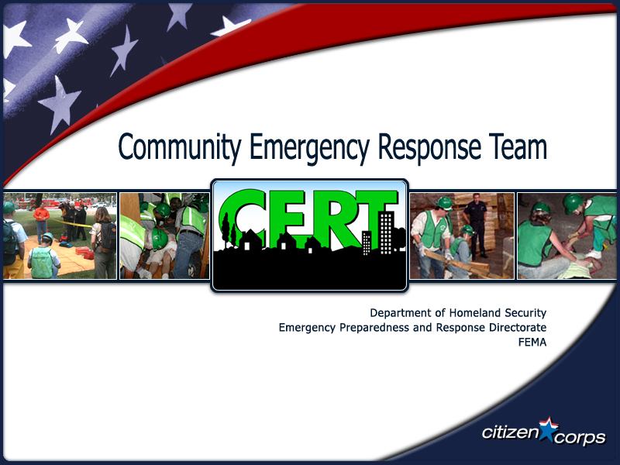

Slide 2
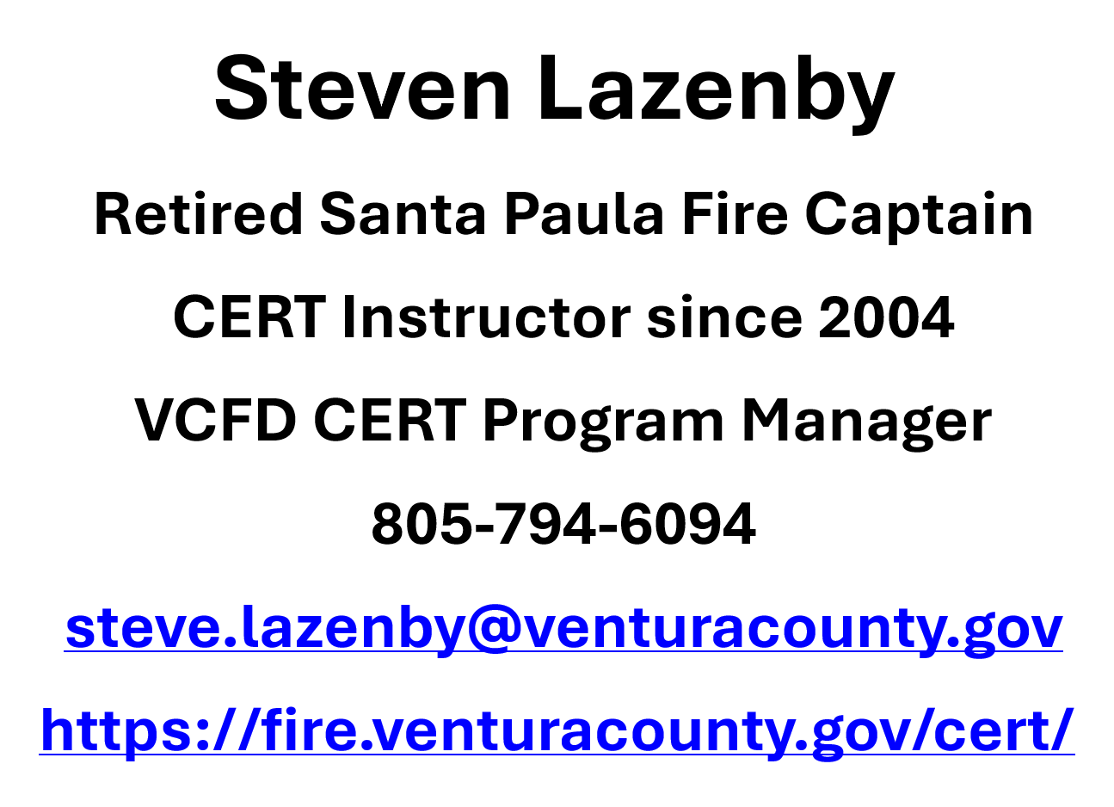

Slide 3
WHY SHOULD YOU AND EVERYONE YOU KNOW TAKE THE CERT TRAINING?
Because you don’t want
to be this guy!

Slide 4
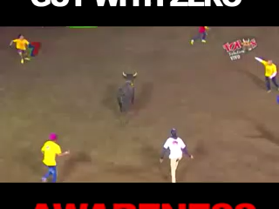

Slide 6
CERT HISTORY
CERT started as a local program with the Los Angeles Fire Department (LAFD) in 1985. The LAFD traveled to Japan to learn how the they responded to earthquakes. By coincidence, an earthquake struck during their visit and LAFD saw first-hand just how helpful the local community was in the response.

Slide 7
CERT HISTORY
Later that year, LAFD traveled to Mexico City after their 8.1 earthquake that killed 10,000 people. They saw how everyday people with no training would step up to help in the immediate aftermath, even digging with their hands to save total strangers.

Slide 8
CERT HISTORY
What if, they wondered, some of the people likeliest to step up and help could be identified, trained, and organized before disaster struck?
When the pilot program volunteers showed how effective they were as force multipliers during the 1987 Whittier Narrows earthquake in Southern California, emergency managers around the country took notice.

Slide 9
CERT HISTORY
FEMA rolled out a national CERT program in 1993. There are more than 2,700 active CERT groups with over 600,000 volunteers trained.

Slide 10
CERT in Ventura County
A CERT trained person in Ventura County is:
Going to respond to help themselves, their friends, families, neighbors, co- workers and even complete strangers
A recognized “First Responder”
Better prepared and trained than the average citizen of our communities.
In most cases you will not be “Deployed”

Slide 11


Slide 12
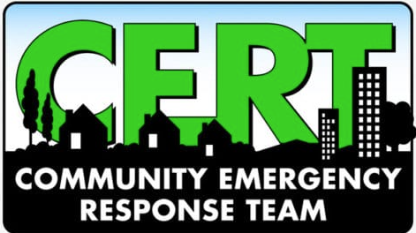
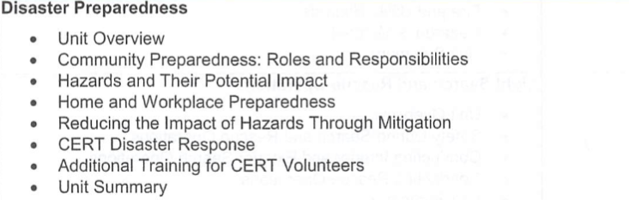
CLASS ONE

Slide 13
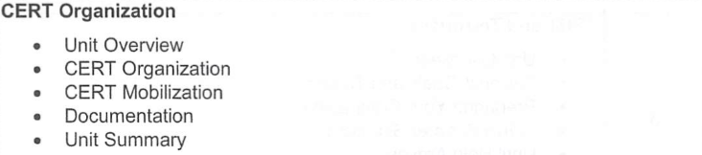
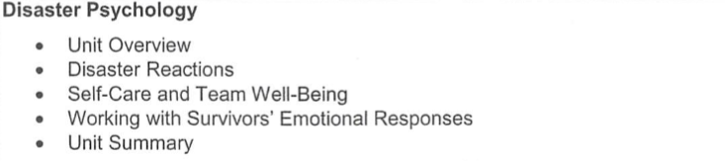
CLASS TWO
CERT Organization / Disaster Psychology

Slide 14
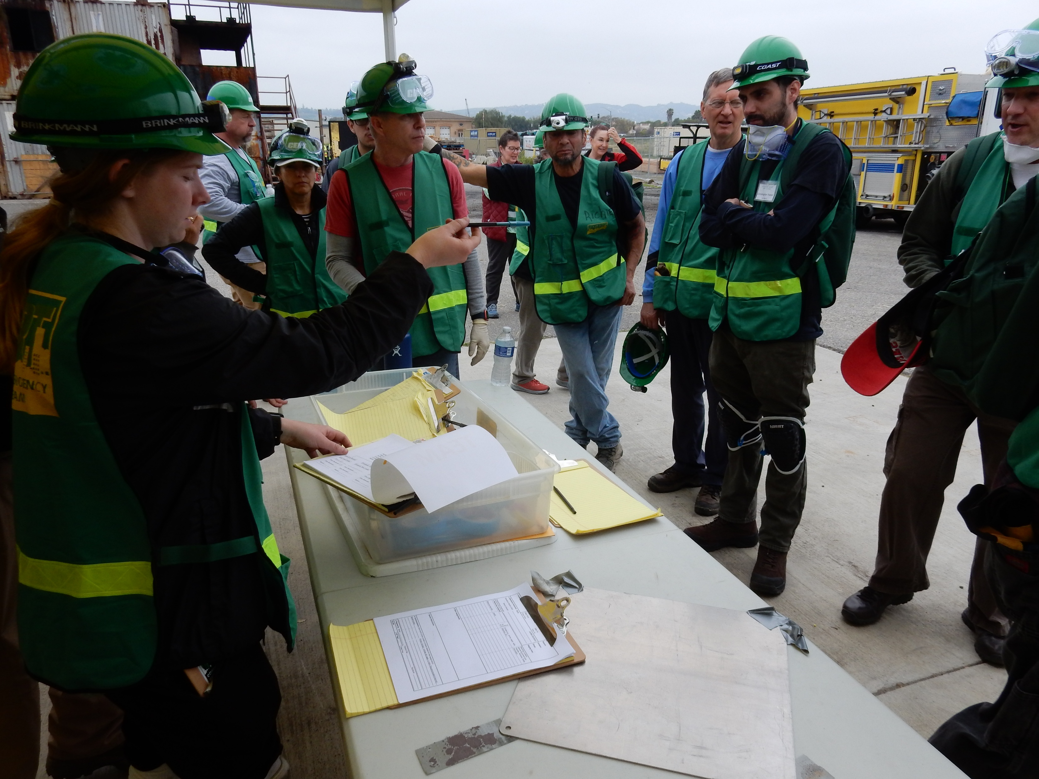
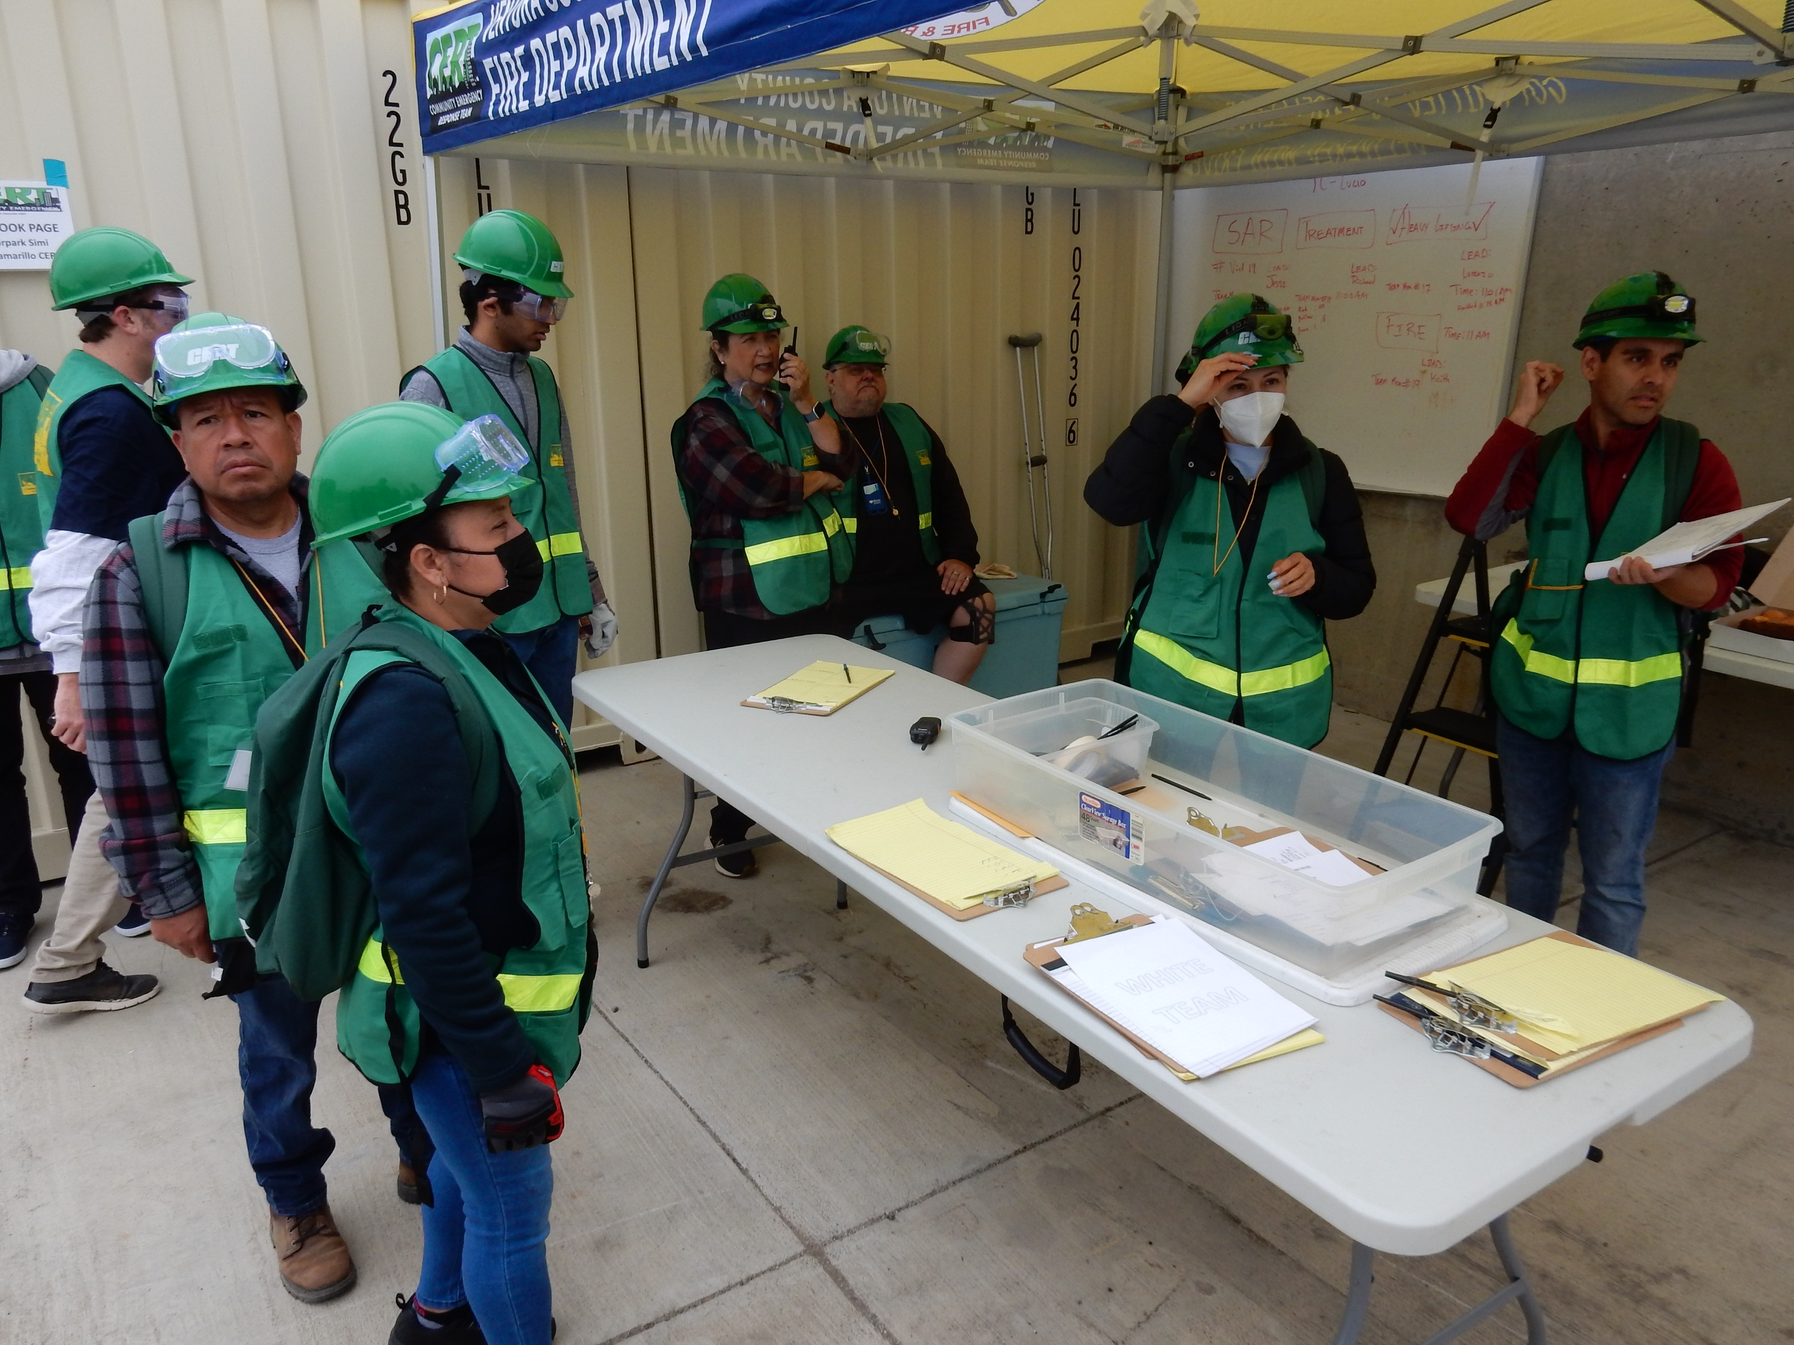

Slide 15
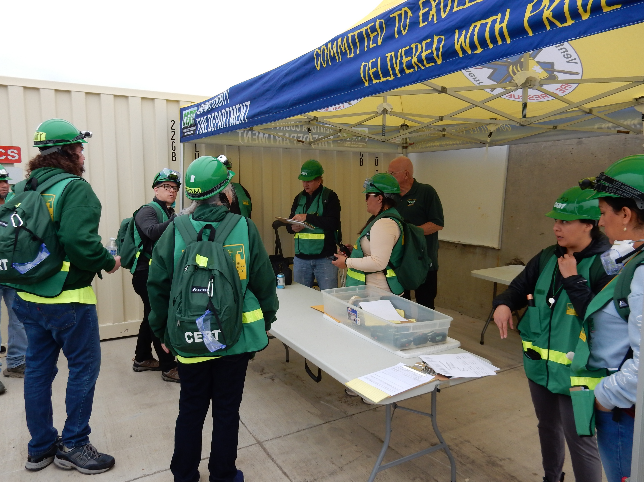
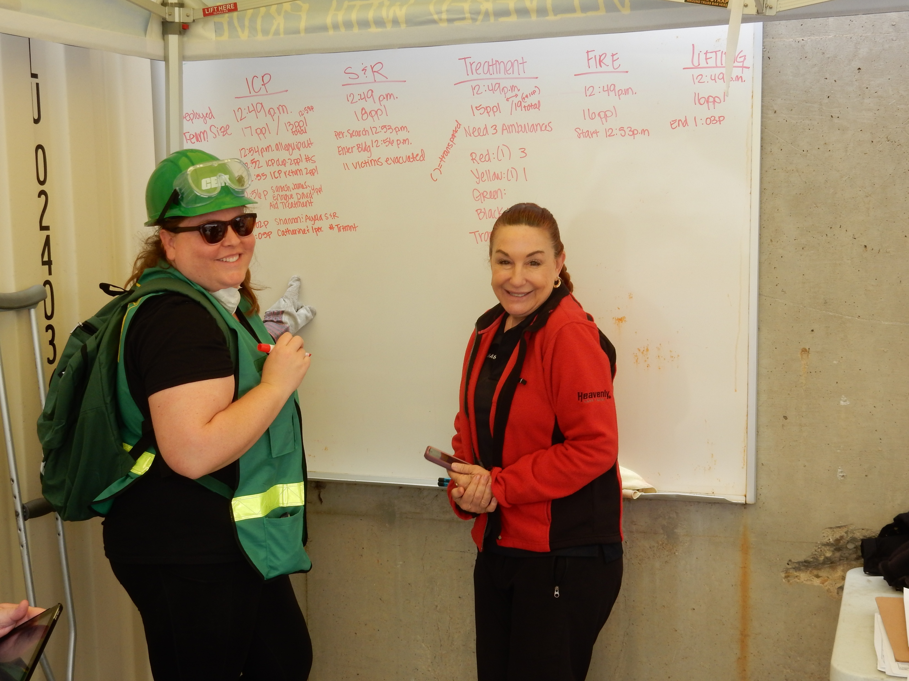

Slide 16
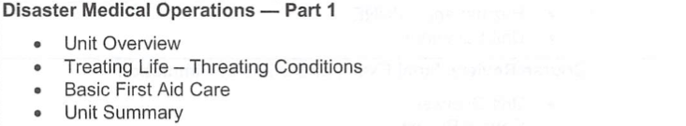
CLASS THREE
Disaster Medical Part 1 / Patient Care / ID Life Threatening Conditions / Basic 1st Aid / Signs of and Shock Treatment / Public Health / Treating AND Bandaging Wounds

Slide 17
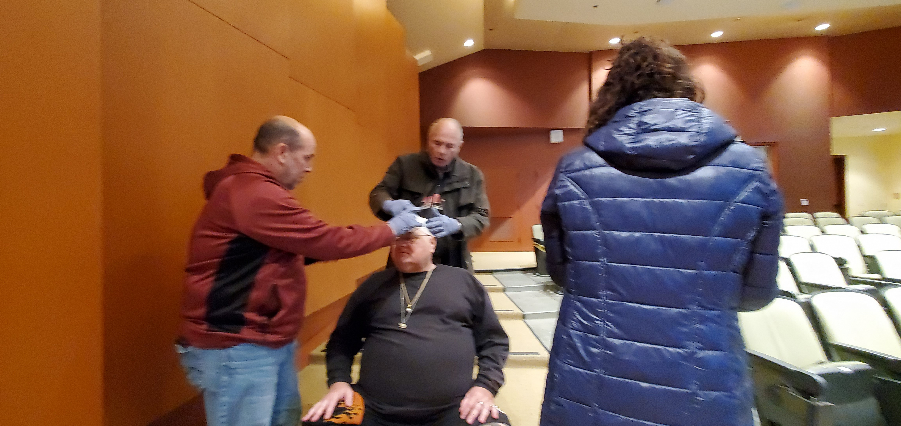
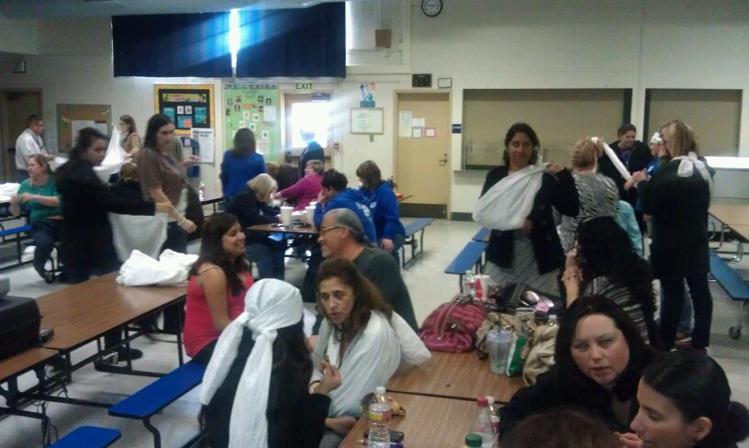

Slide 18
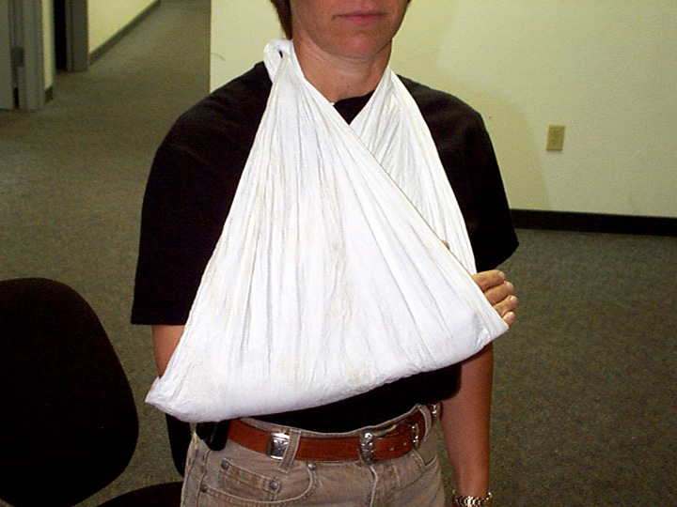
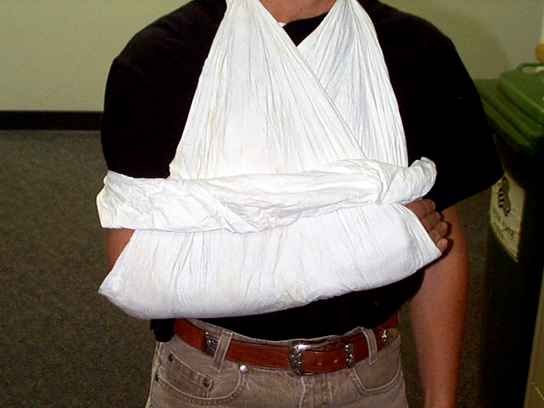
Treatment of an Injured Arm or Hand
If possible place the arm in the “Pledge Allegiance” position
  Hand high
  Prepare for transport
  If unable to move
    Splint in the position found
To Finish - Apply sling & binder

Slide 19
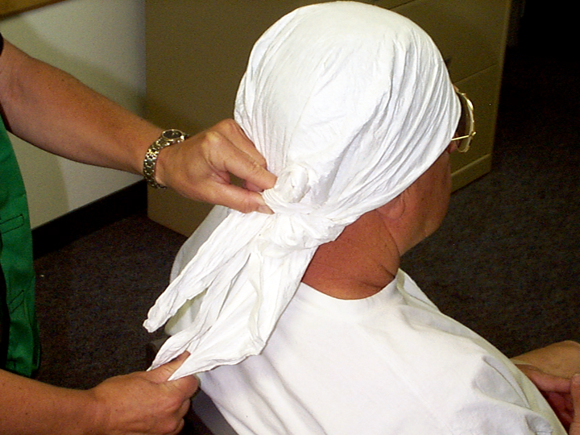
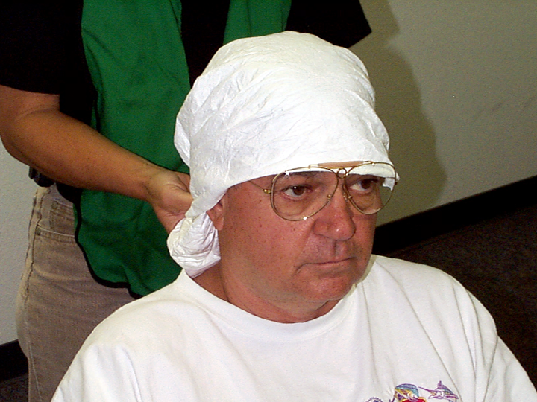
Head Bandage
Use a triangular bandage
  Short tail in center
  Long tails around sides
    Long tails over short in back
Crisscross long tails and bring to front and tie
Pull short tail tight and tuck

Slide 20
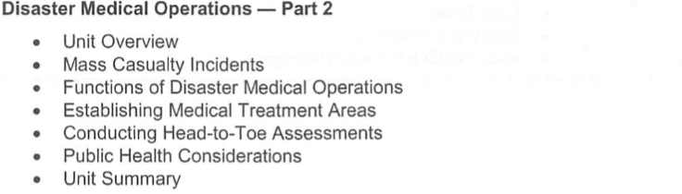
CLASS FOUR
Disaster Medical – Part 2 / MCI / Set Up Treatment Area / Hands Only CPR / START Triage

Slide 21
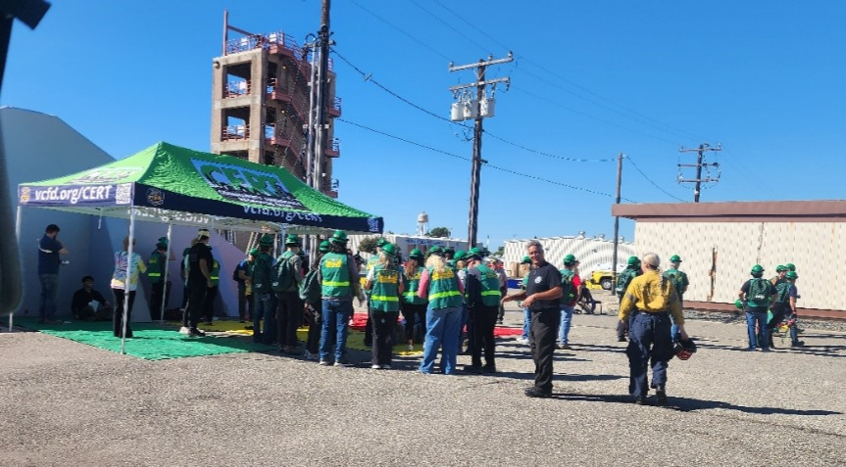

Slide 22
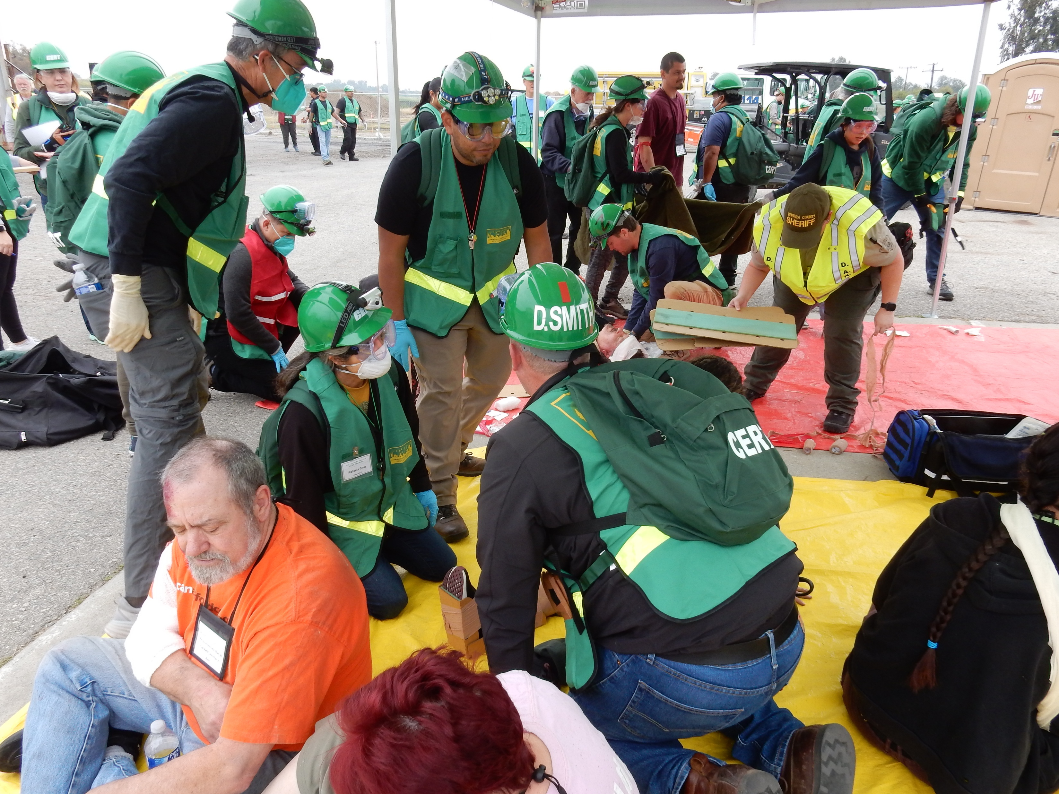
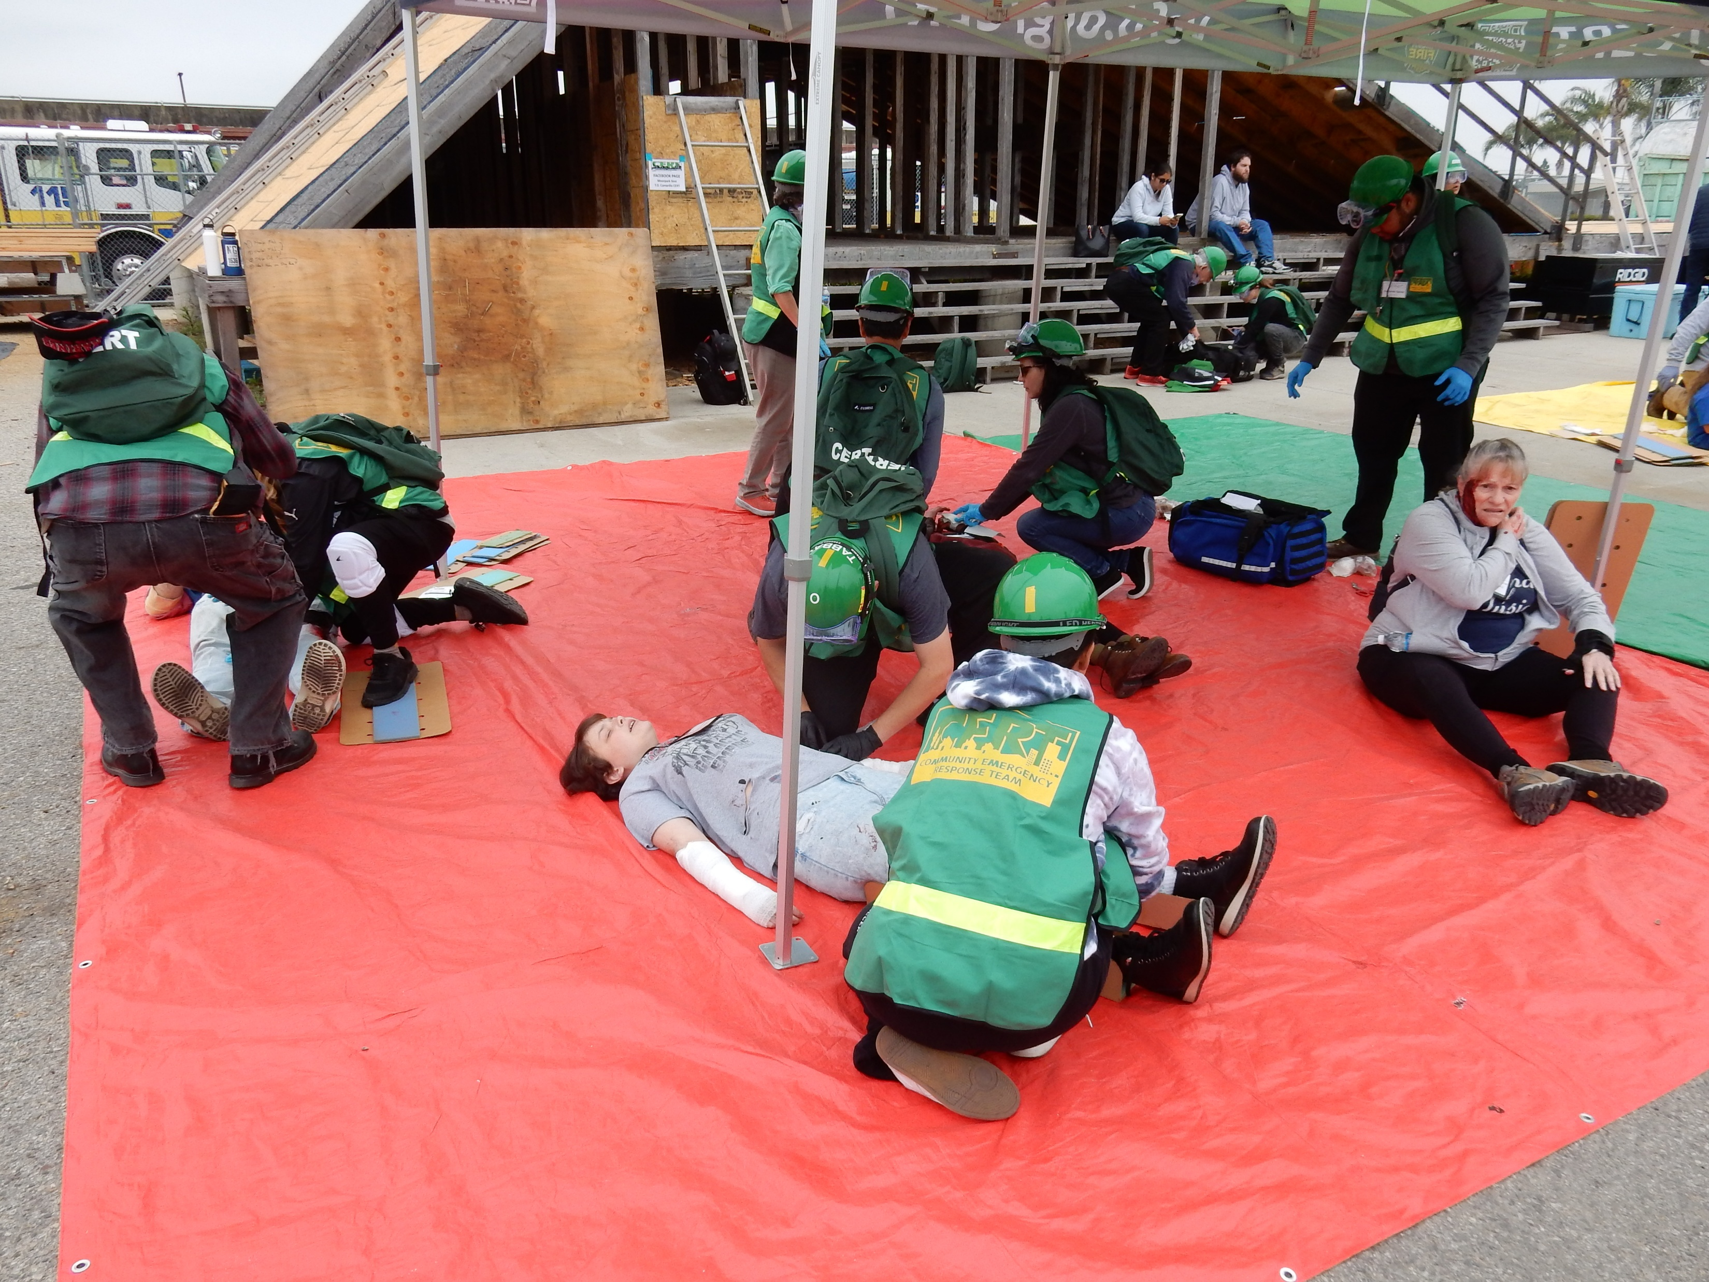
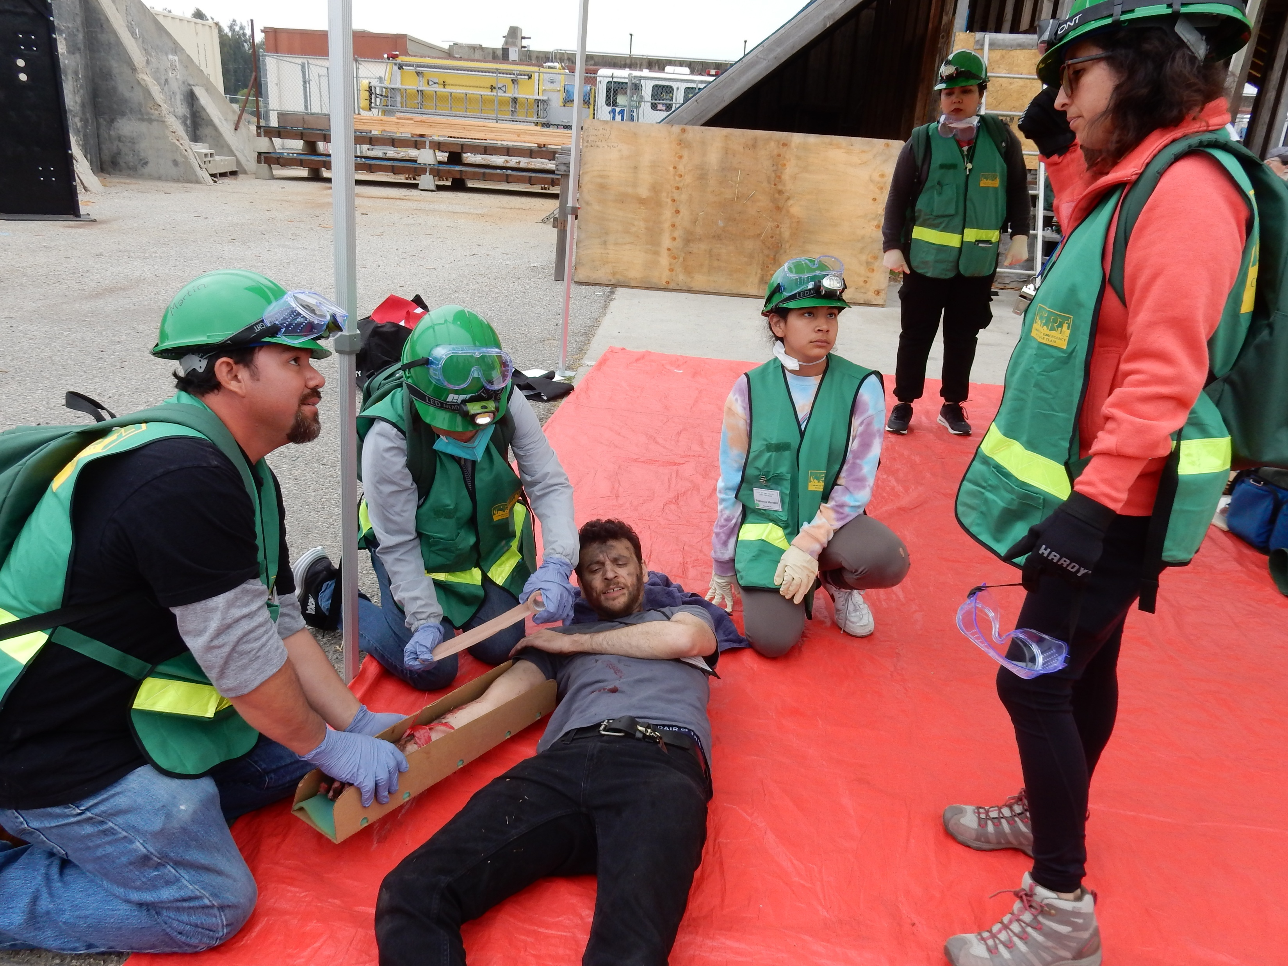

Slide 23
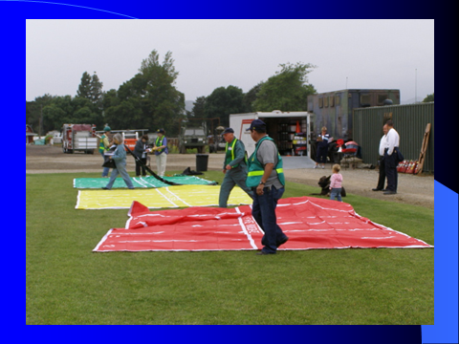

Slide 24
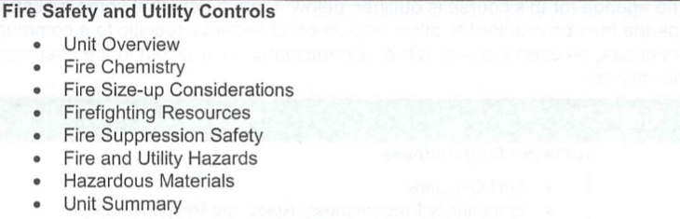
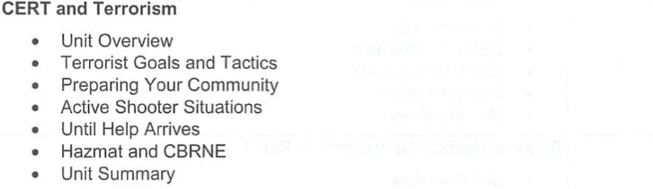
CLASS FIVE
Fire Safety and Utility Controls / Small Fire Suppression / CERT & Terrorism – CERT Kit Distribution

Slide 25
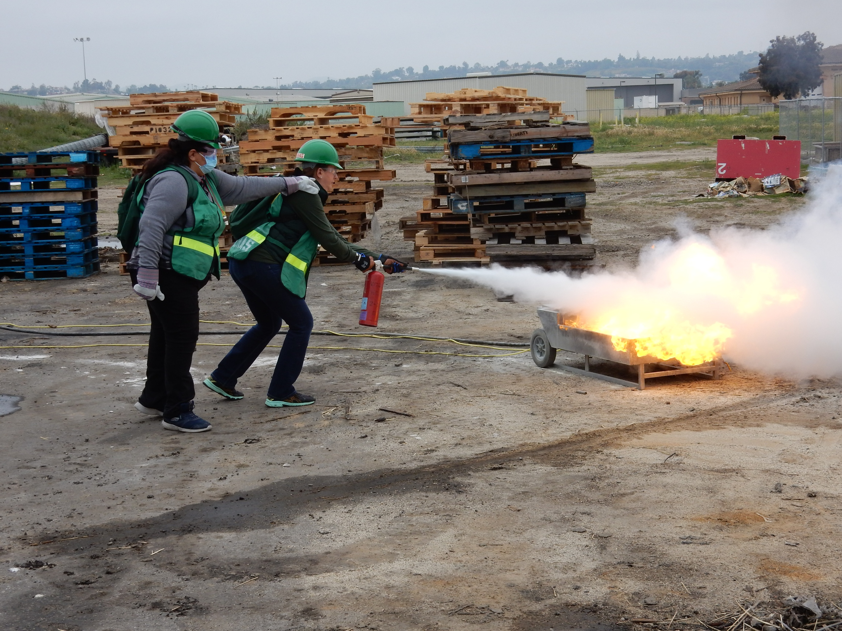
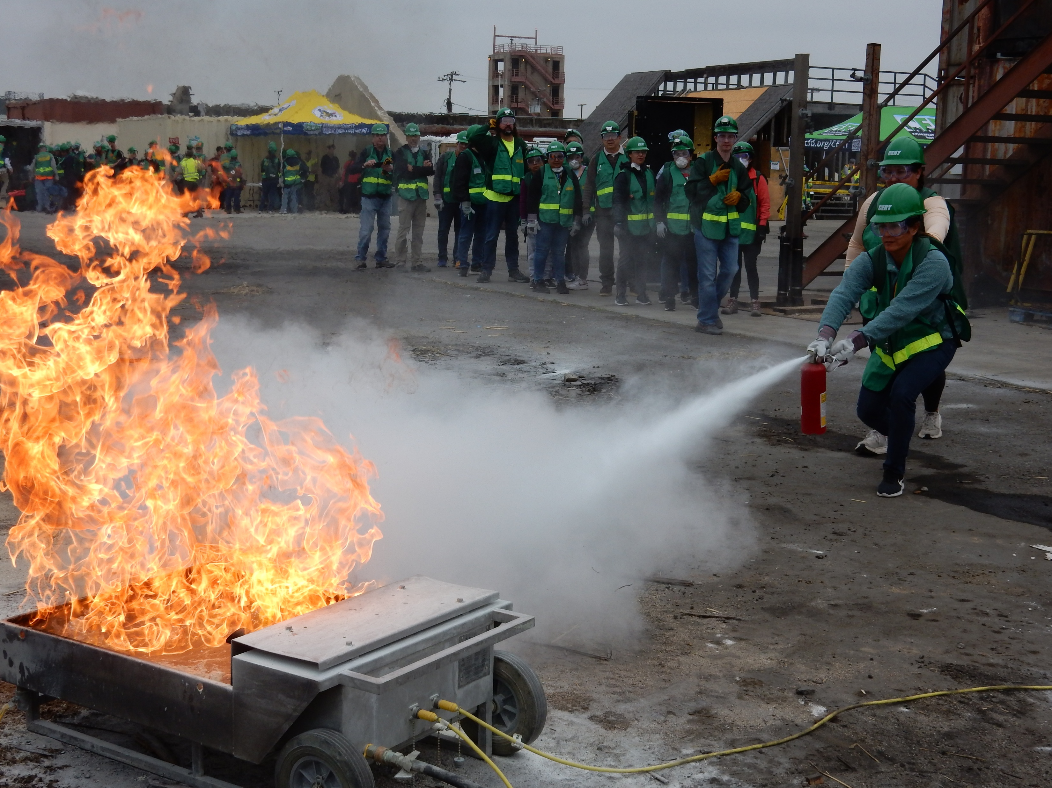

Slide 26
Utility Shut-Off

Slide 27
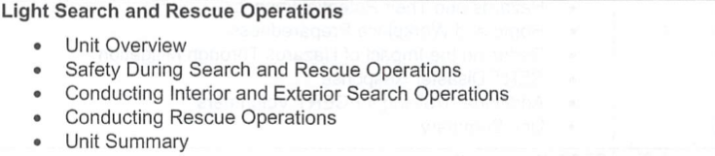
CLASS SIX
Light Search & Rescue / Cribbing and Lifting / Patient Movement / Course Review & Drill Introduction

Slide 28
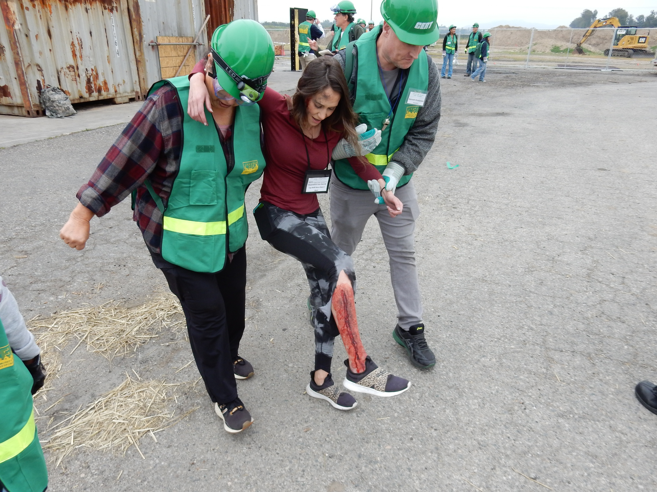
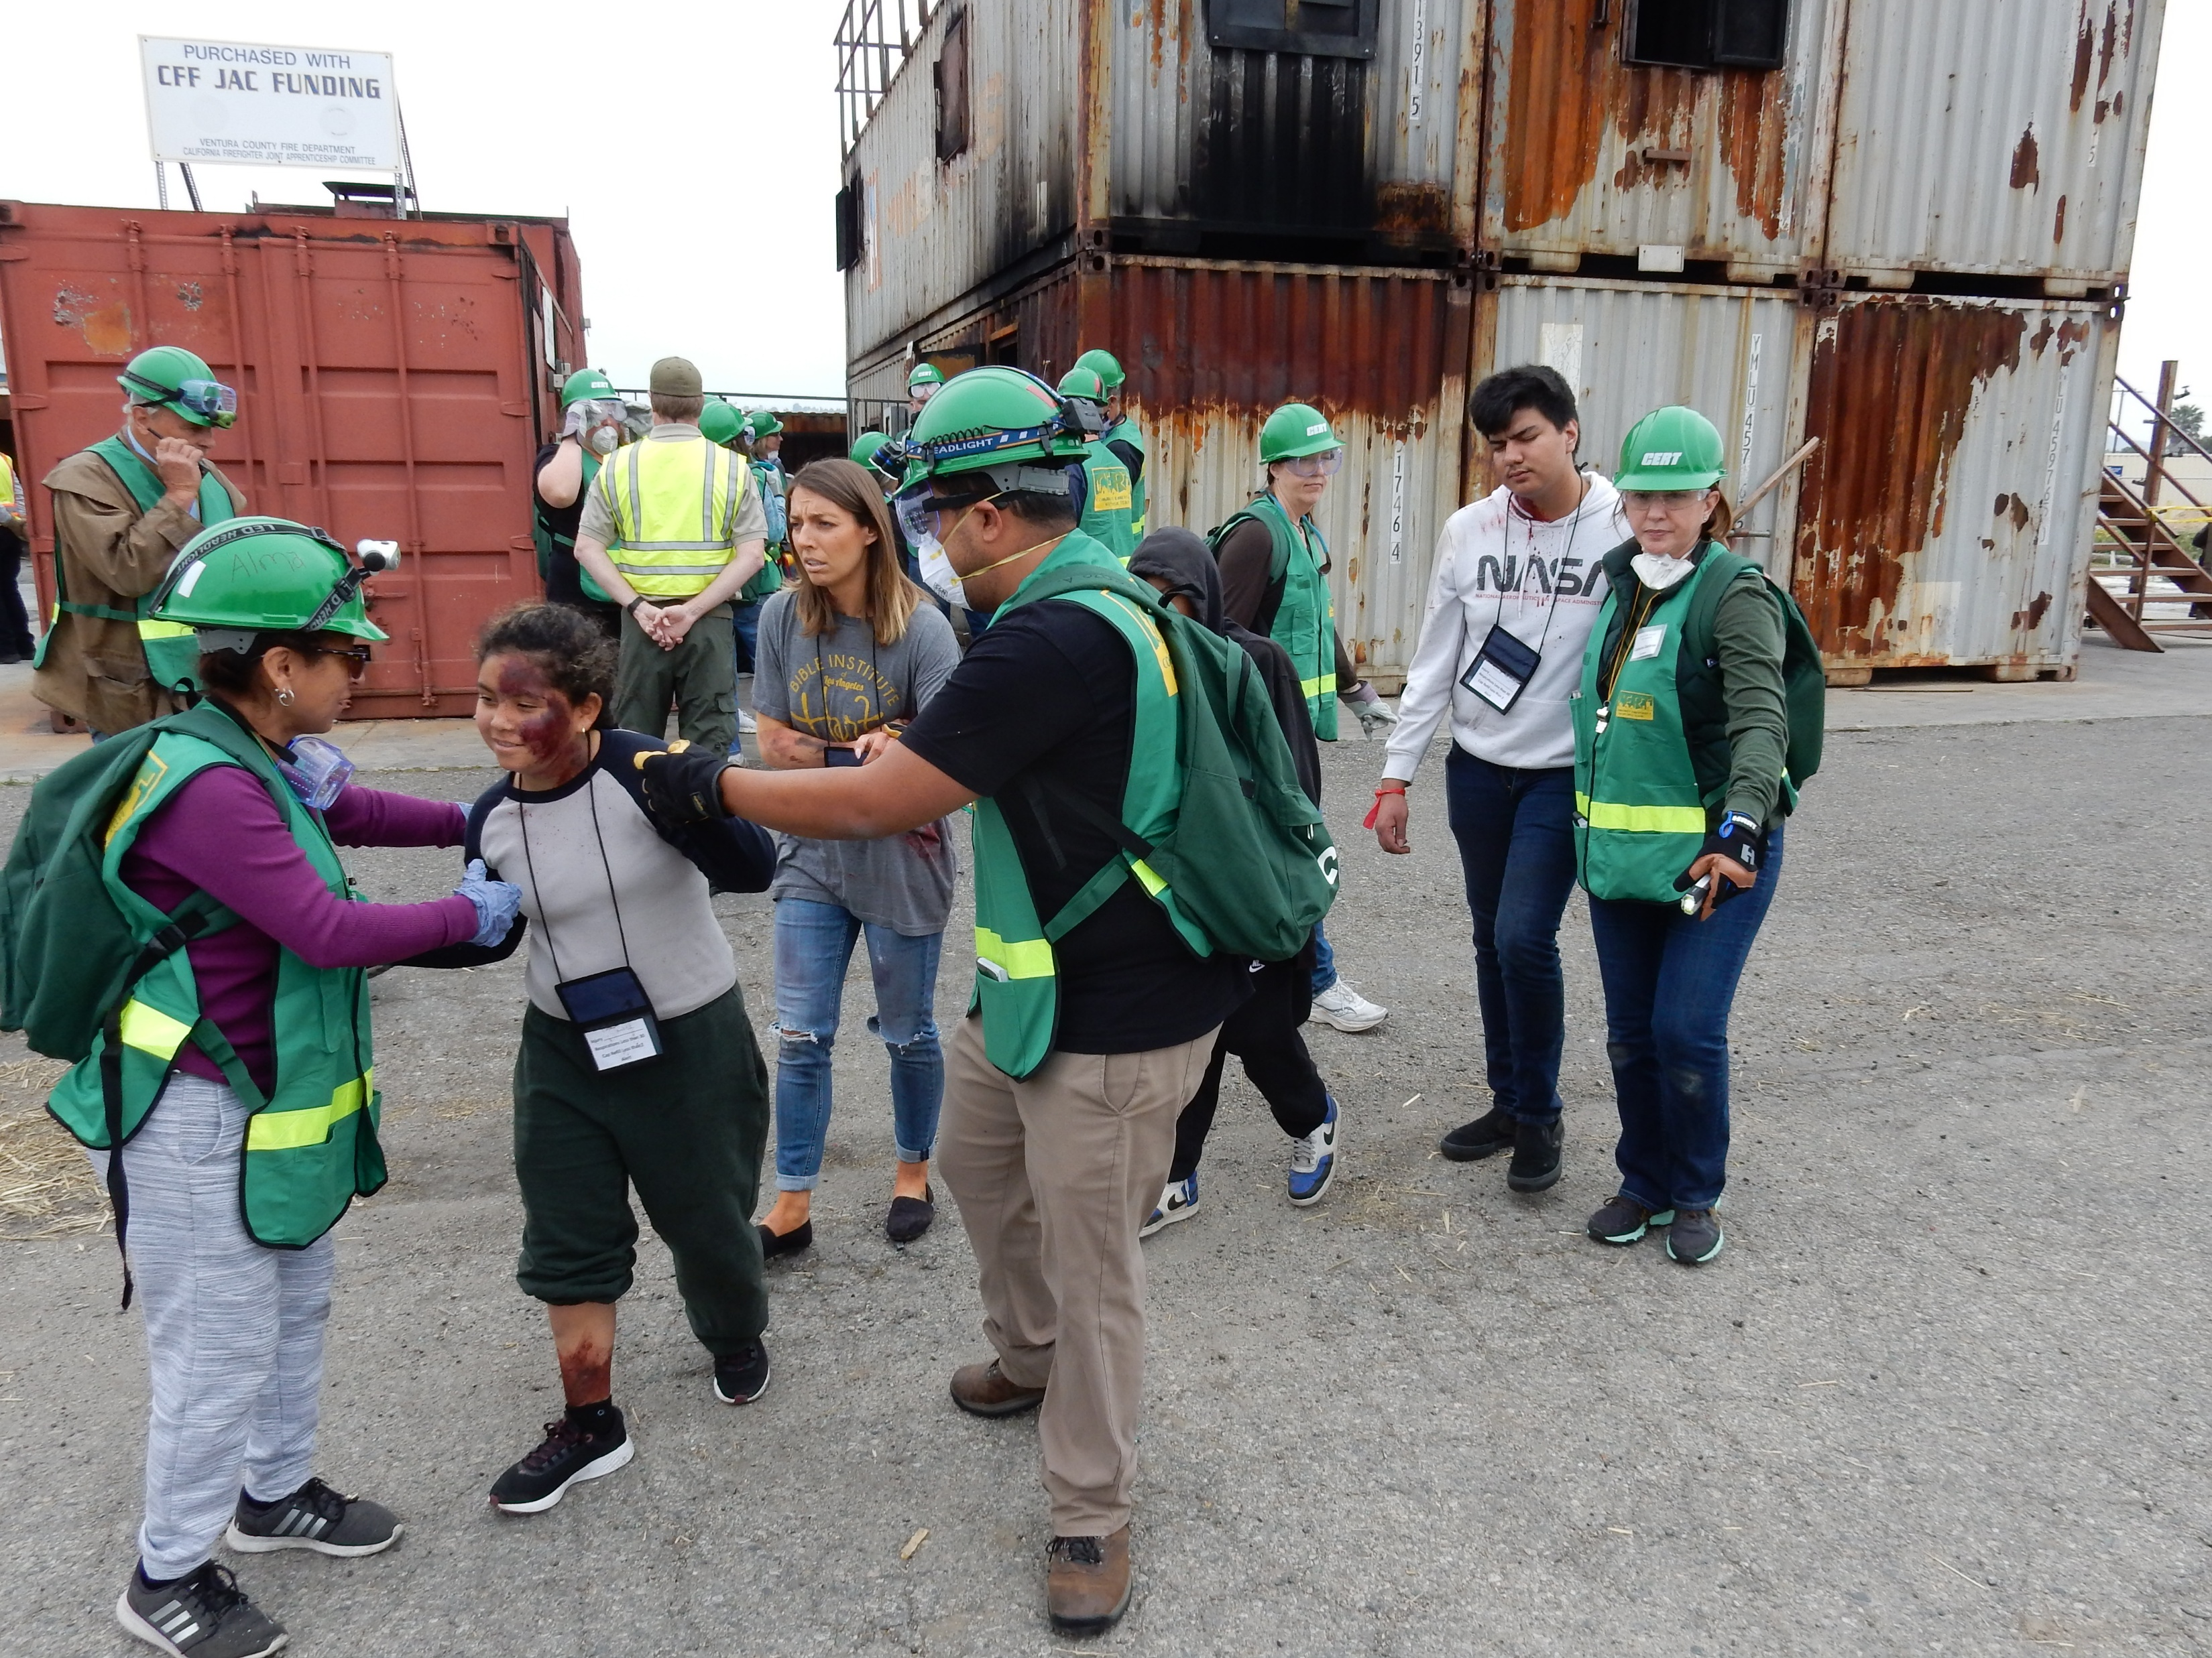
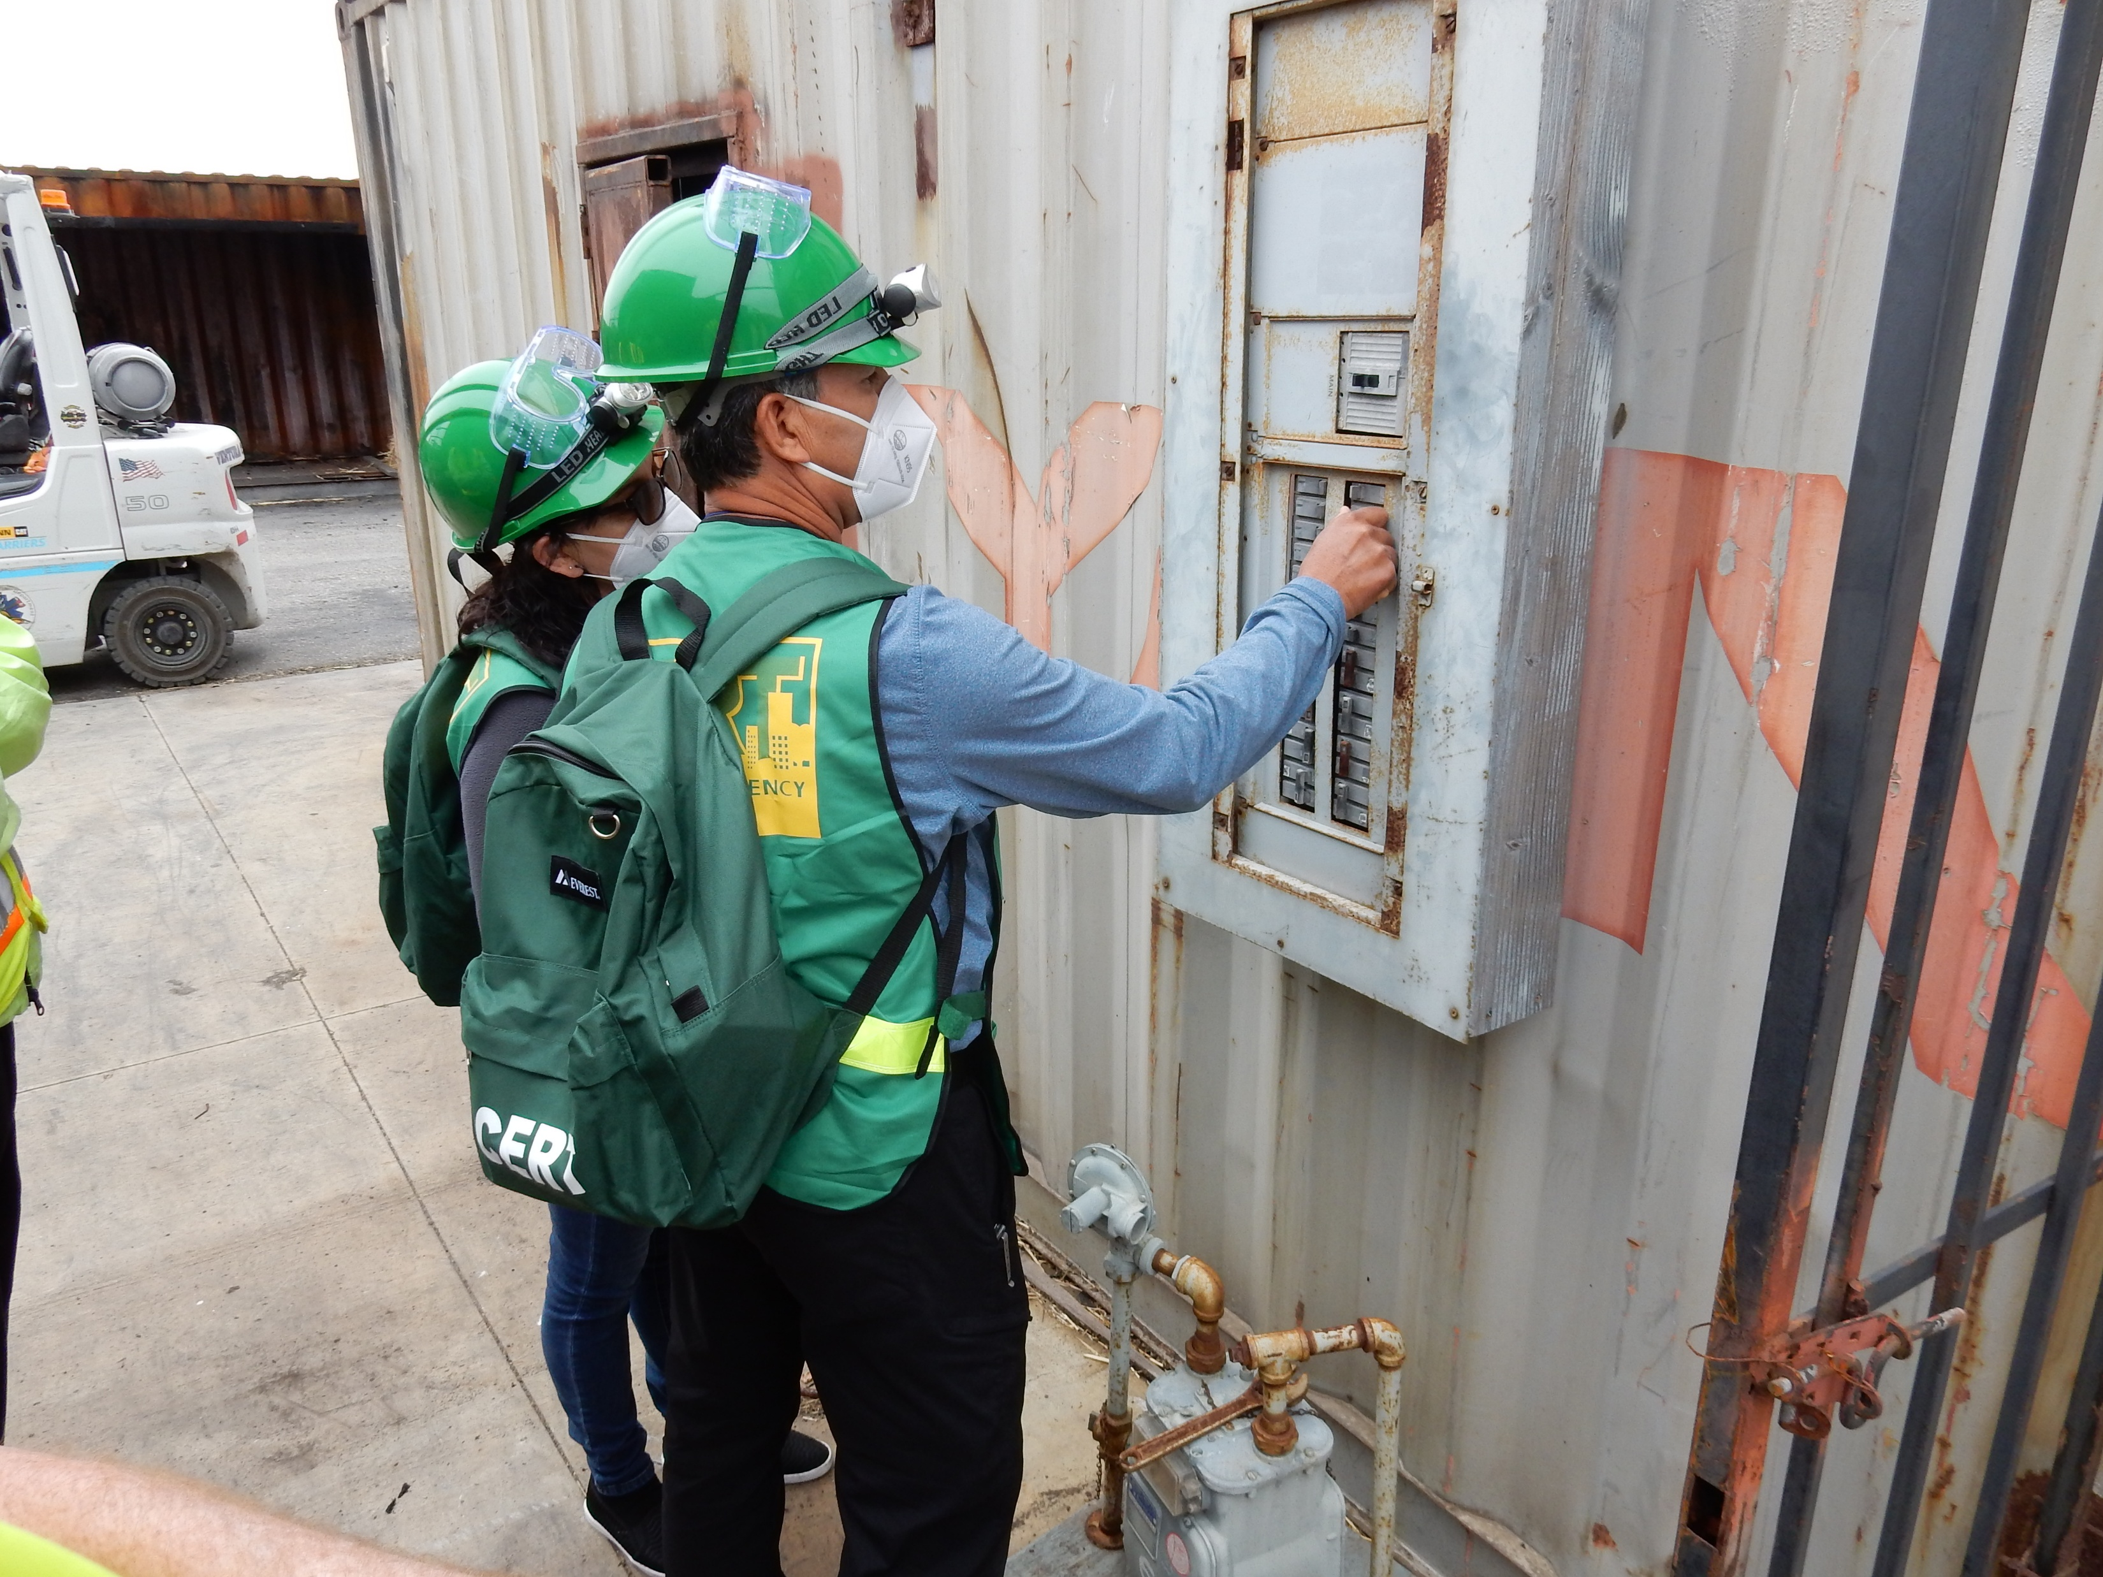

Slide 29
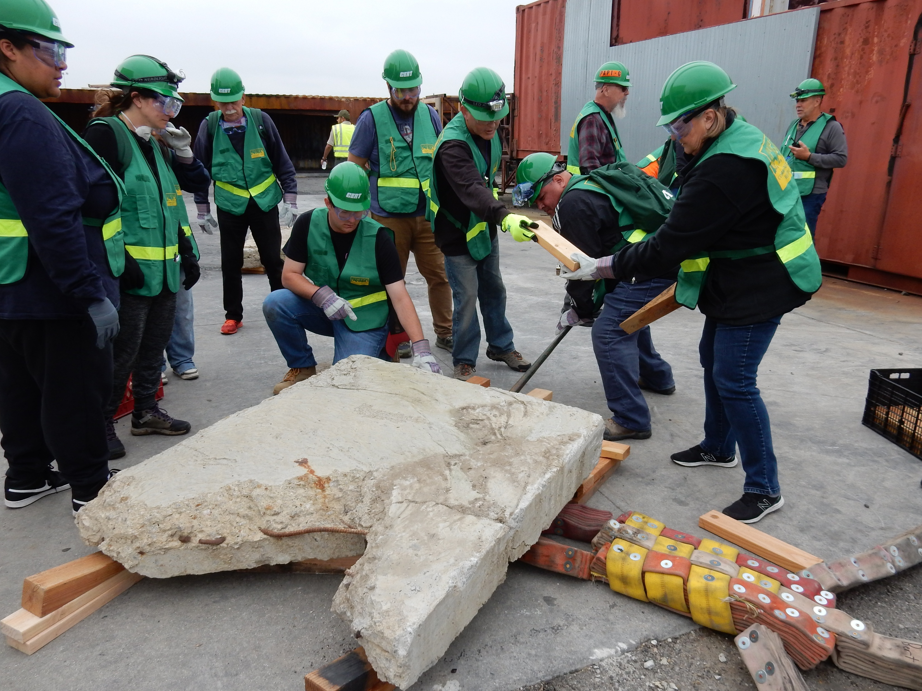
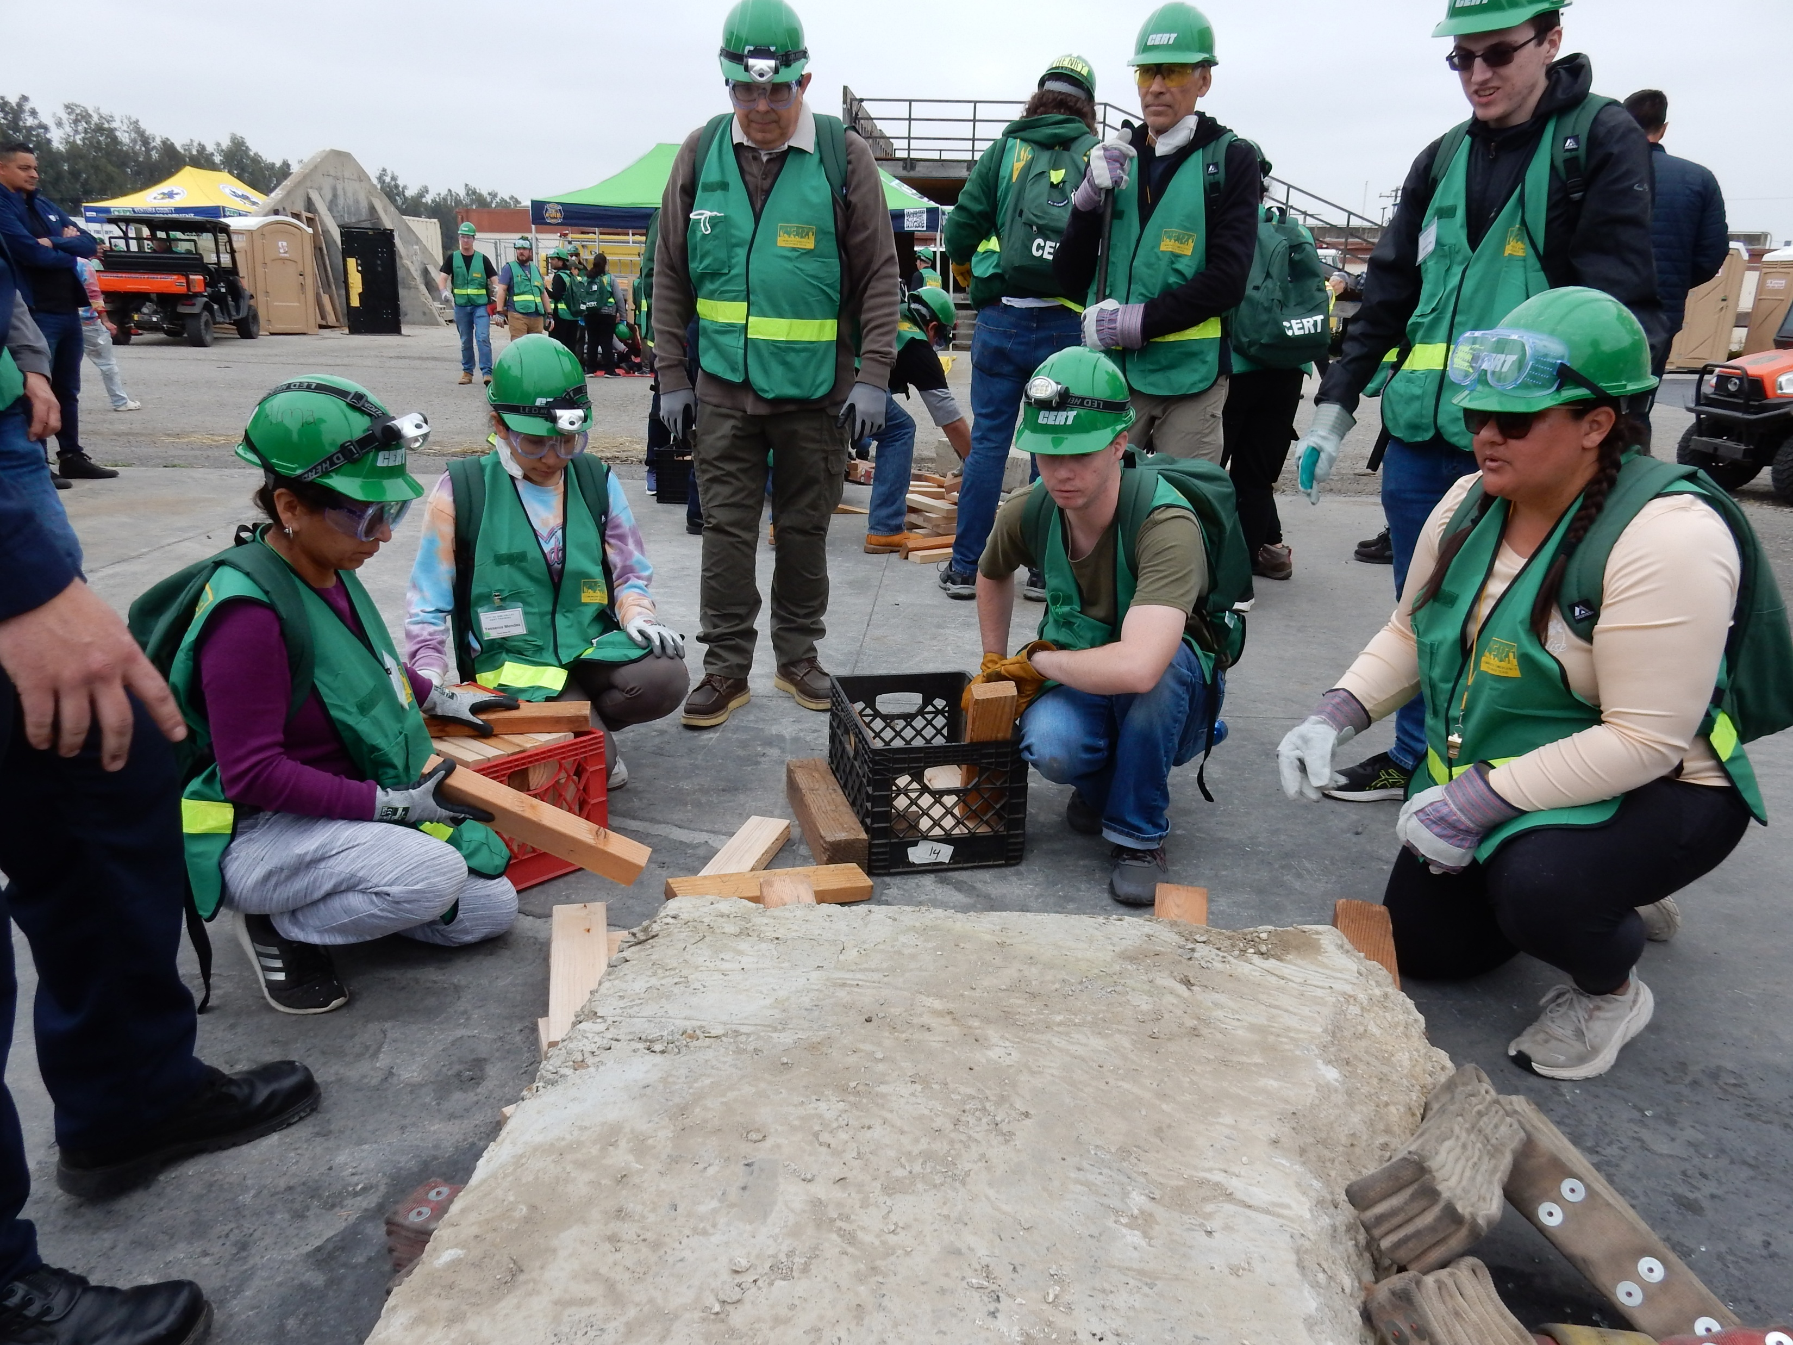

Slide 30
FINAL CLASS DRILL
Final Exam / Disaster Simulation (4 hours)
The scenario for the drill is that a significant earthquake has damaged buildings injuring people that are stuck, confined, lost or trapped in facilities at the drill grounds. In addition, there are multiple fires and heavy objects to be lifted to free subjects.

Slide 31
Local Class Requirements
A suitable location to conduct the class
A person to be for promoting, organizing and tracking the class
Minimum of 25 students required to conduct the class
The classes meet once a week, evenings, for 6 weeks. Classes are 3 hours.
Drill on Saturday for 4 hours.
To complete the course, you must attend every class
The class is free and intended for adults (Some exceptions are possible)
https://fire.venturacounty.gov/cert/

Slide 32
QUESTIONS AND DISCUSSION
Any questions or comments?
Discussion:
Create a cert program in somis?
Attend existing classes in other communities?

