Slide 1
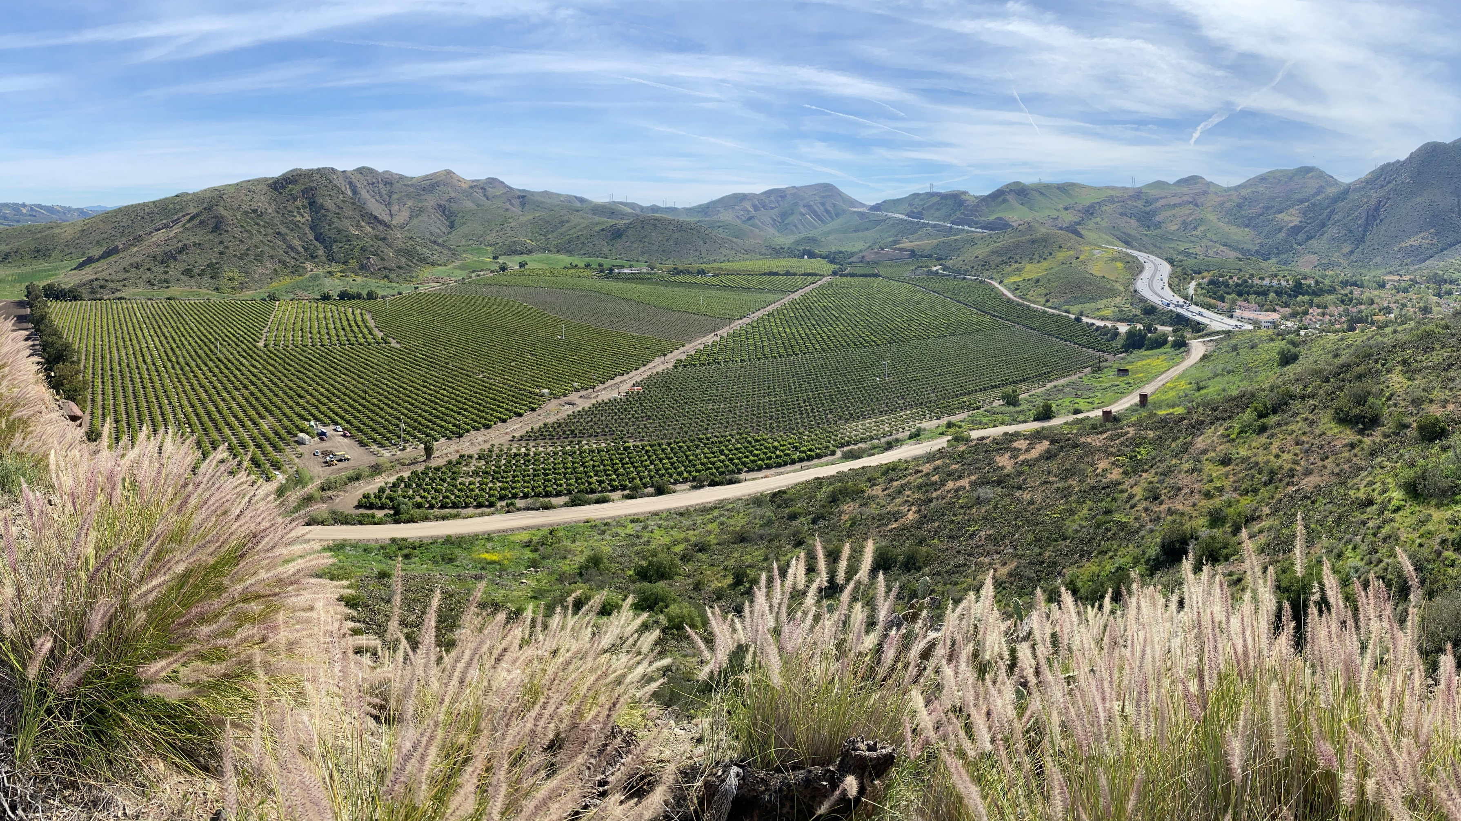
Agriculture in Ventura County
Korinne Bell
Agricultural Commissioner
June 18, 2026

Slide 2

California is by far the largest agricultural producer in the U.S., generating more agricultural output (over $60 billion annually) than any other state.
Research historically indicates that California would rank roughly in the top-10 globally in agricultural output if it were compared to other countries, ahead of countries like Canada, Mexico, Germany, and Spain in total agricultural production value.
Depending on the ranking methodology, some estimates place it between 5th and 9th largest worldwide in agricultural production.

Slide 3
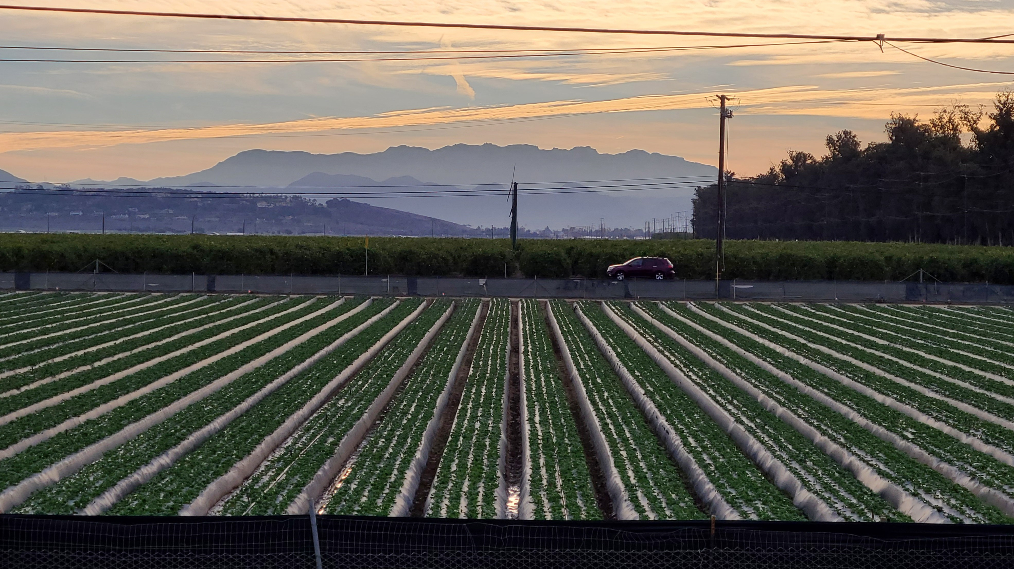
Ventura County is the Number 5 Global Exporter…
Ventura County Truly Feeds the World!

Slide 4
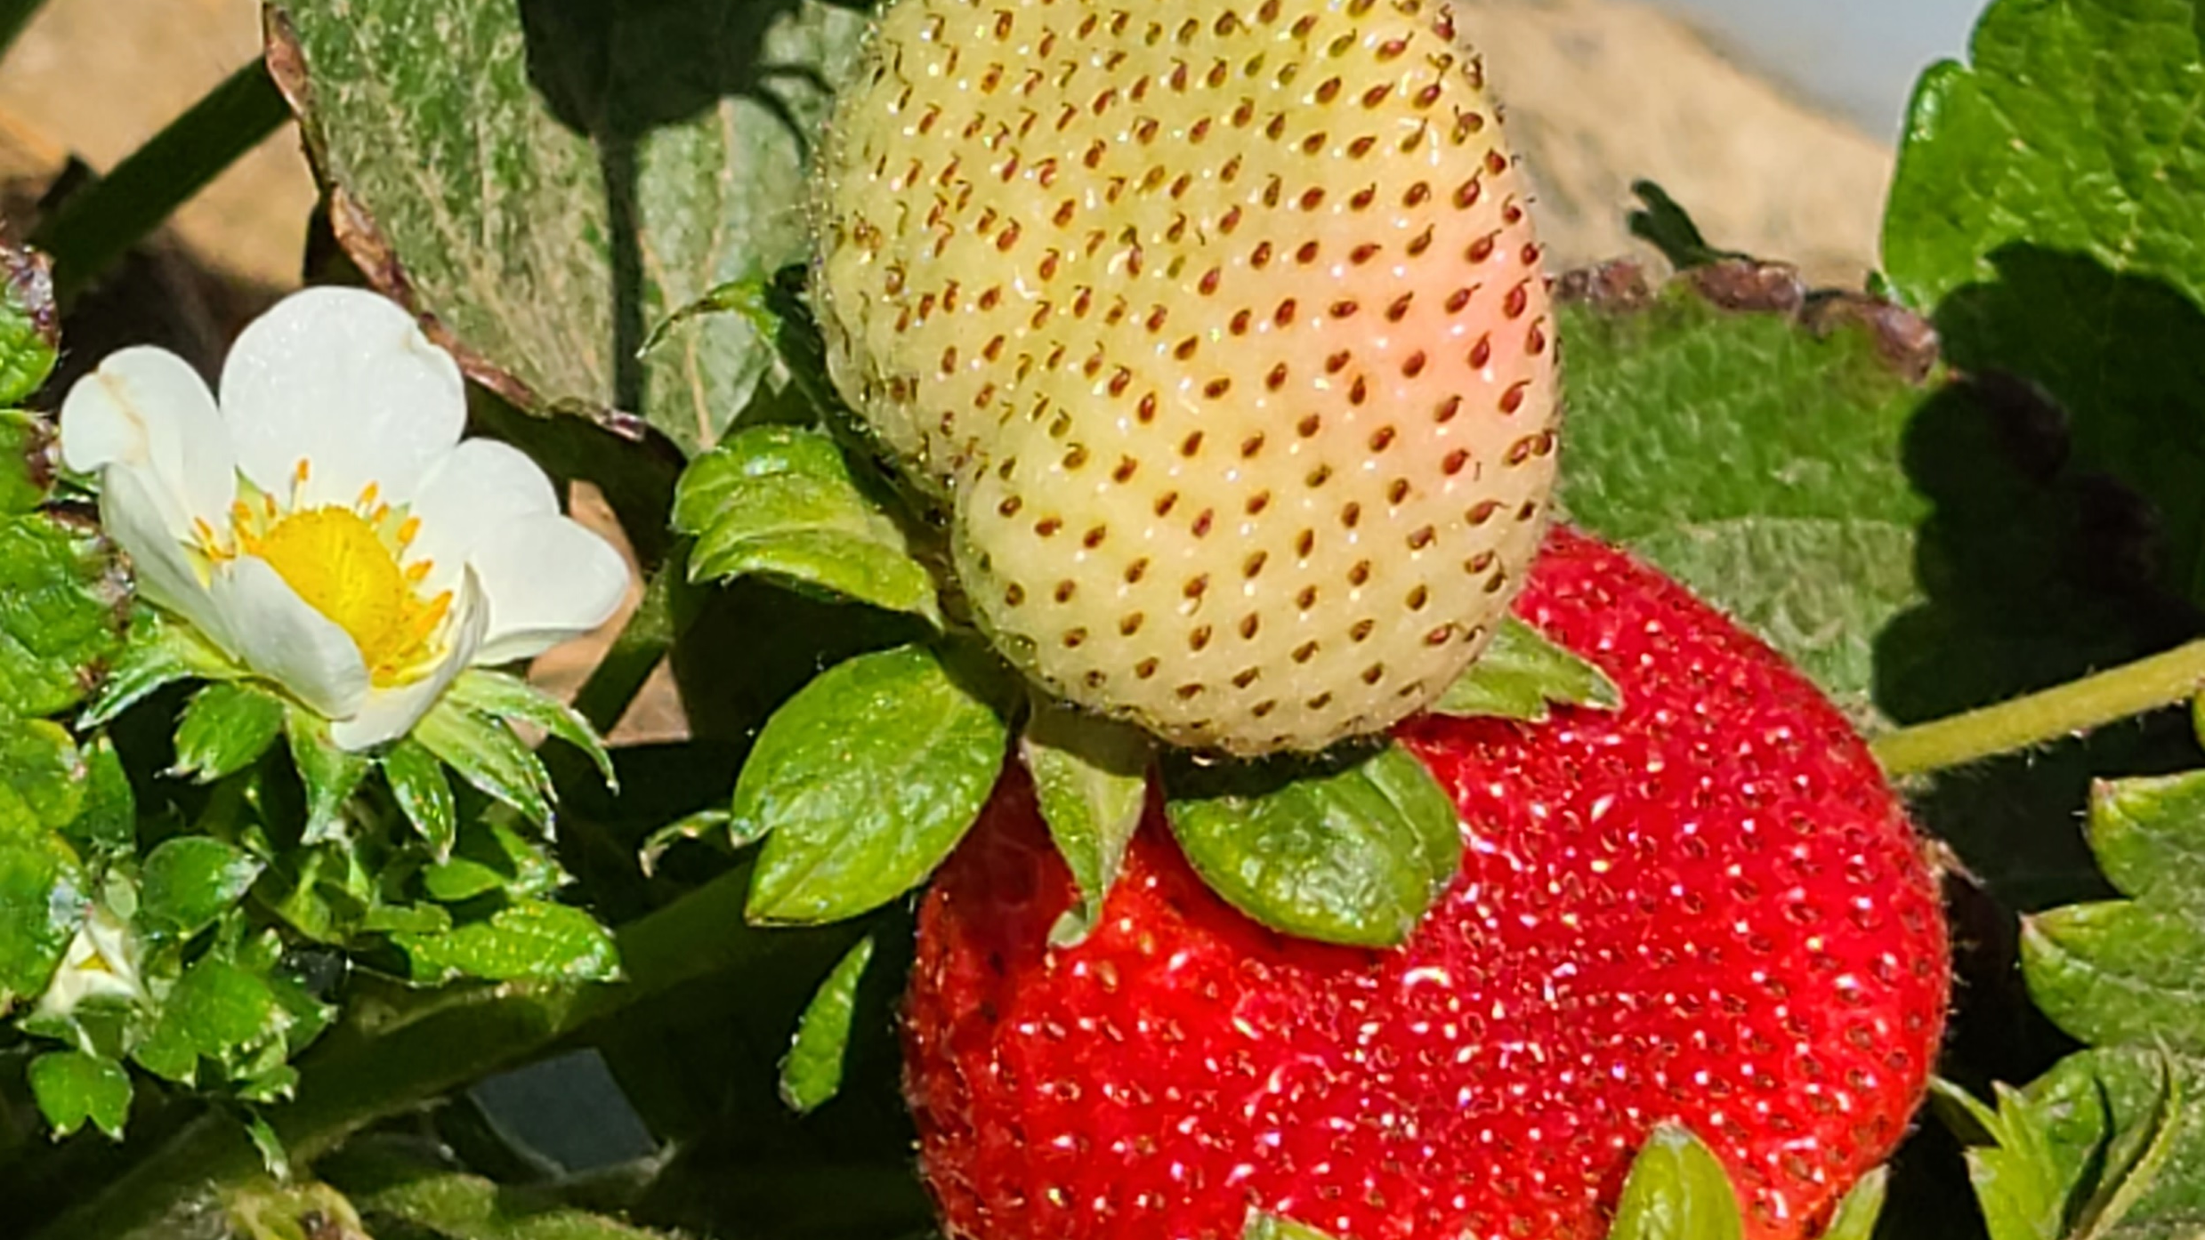
Rank | Crop | Value
1 | Dairy products (milk) | $8.6 B
2 | Almonds | $5.7 B
3 | Grapes | $5.6 B
4 | Cattle & calves | $5.0 B
5 | Lettuce | $3.7 B
6 | Strawberries | $3.5 B
7 | Pistachios | $2.0 B
8 | Tomatoes | $1.6 B
9 | Carrots | $1.6 B
10 | Broilers | $1.4 B
California’s Top Ten:
The state produces roughly half of the U.S. vegetables and more than 75% of its fruits and nuts

Slide 5
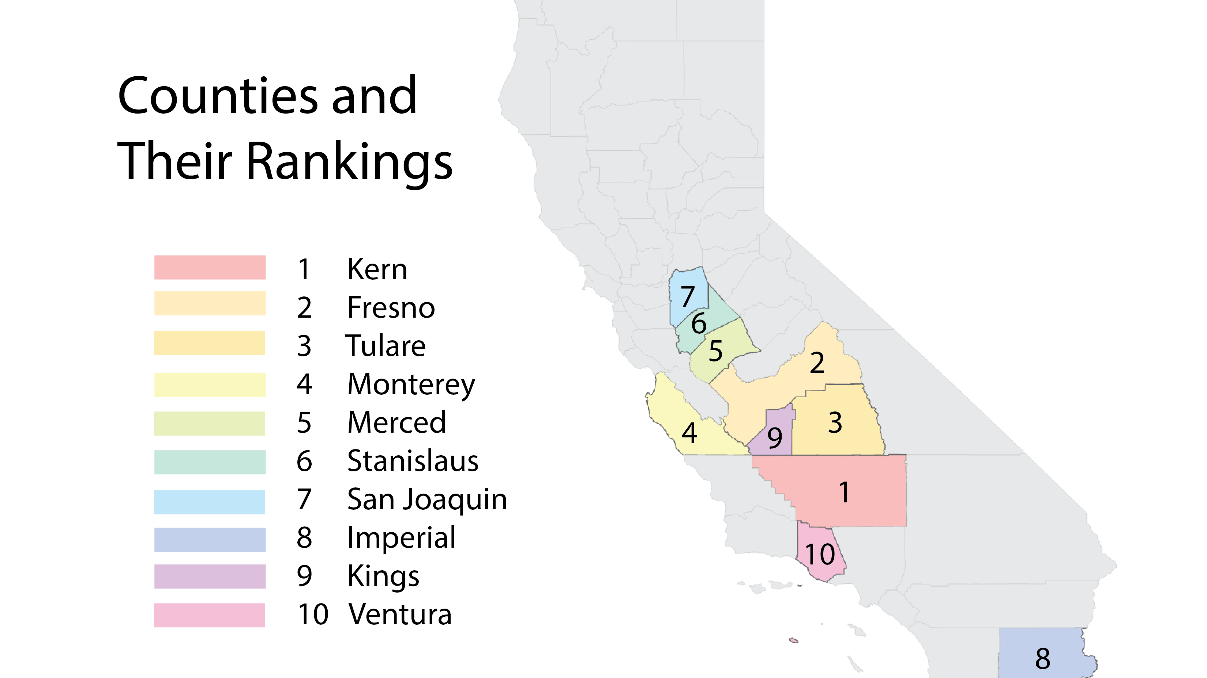

Slide 6
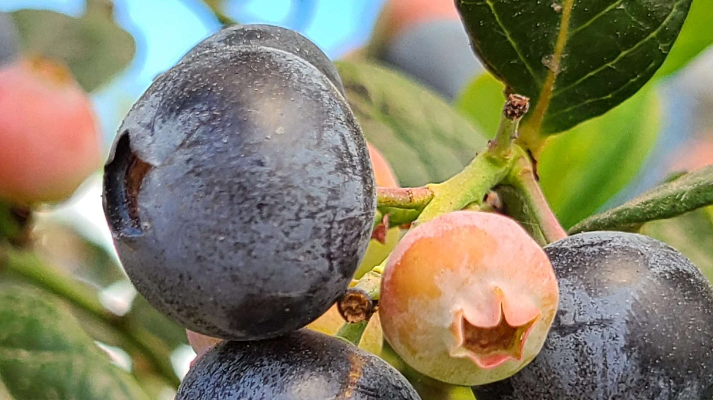
Rank | Crop | Value
1. | Strawberries | $708,690,000
2. | Avocados | $338,968,000
3. | Nursery Stock | $186,669,000
4. | Celery | $163,436,000
5. | Raspberries | $162,284,000
6. | Lemons | $117,851,000
7. | Peppers | $111,044,000
8. | Blackberries | $71,558,000
9. | Blueberries | $46,858,000
10. | Tomatoes | $41,820,000
Ventura County’s Top Ten

Slide 7
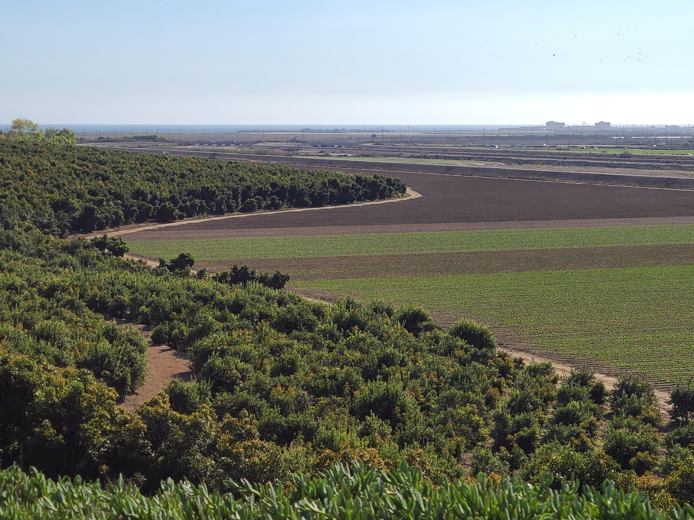
How Ventura County Ranks in CA
1st: Avocados, Raspberries, Cilantro
2nd: Lemons, Celery, Peppers, Blackberries, Cabbage, Beets
3rd: Nursery, Kale, Strawberries, Brussels Sprouts
4th: Carrots
5th: Lettuce, Blueberries, Oranges, Parsley, Tangerines & Mandarins

Slide 8
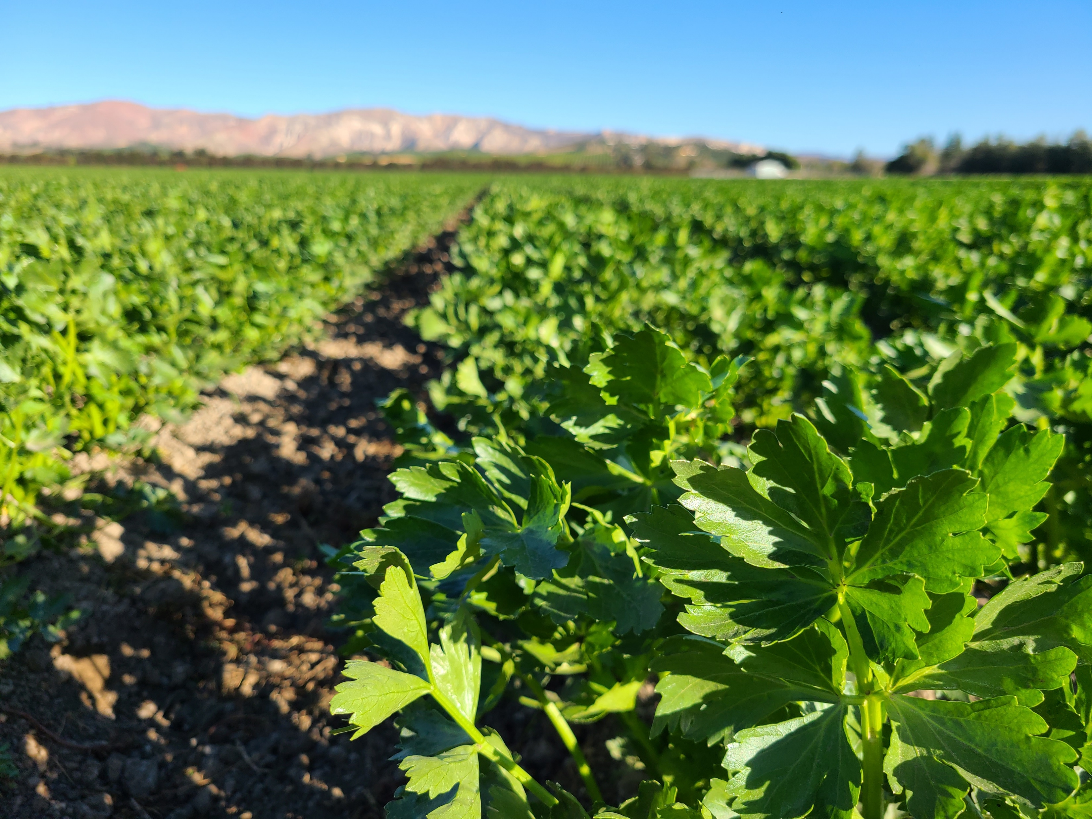
2025 Crop Report
Discusses the costs associated with farming our top ten crops in Ventura County
Labor is by far our biggest cost
Need for STEM

Slide 9

Challenge: Costs of Farming are Increasing Faster than Revenues

Slide 10
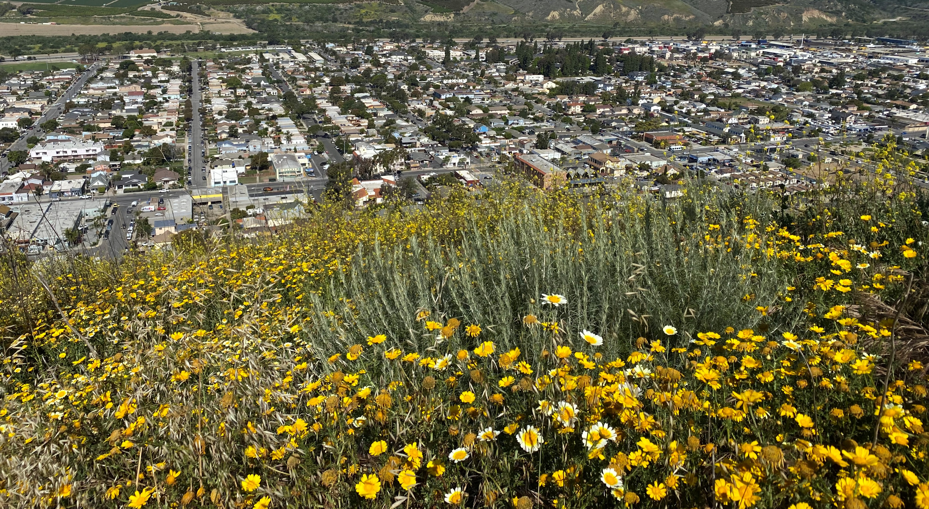
Ventura County is unique in California
in that it is equally ag and equally urban…
Presents unique challenges for farming, especially when it comes to pest control

Slide 11
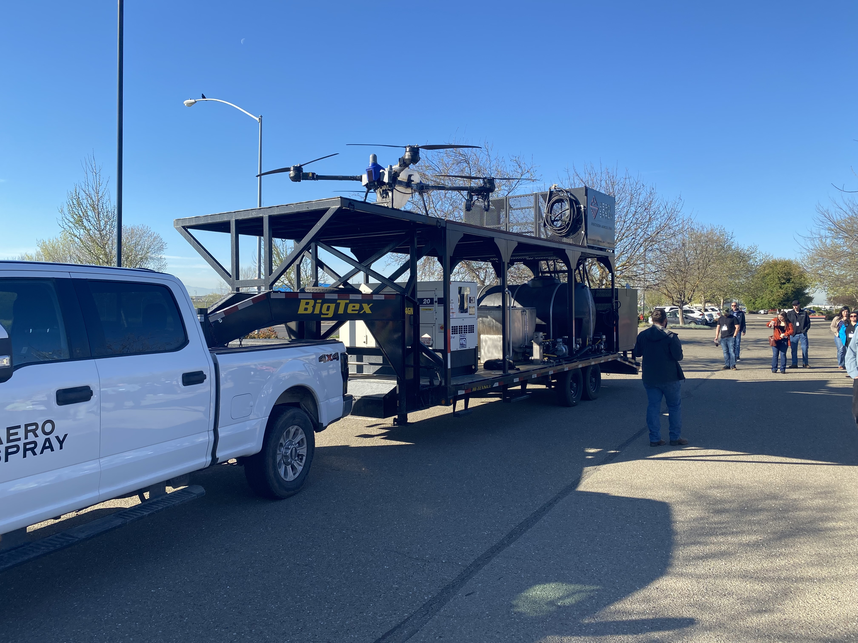
Ag Technology
Drones
Robotics
Heat Imagery

Slide 12
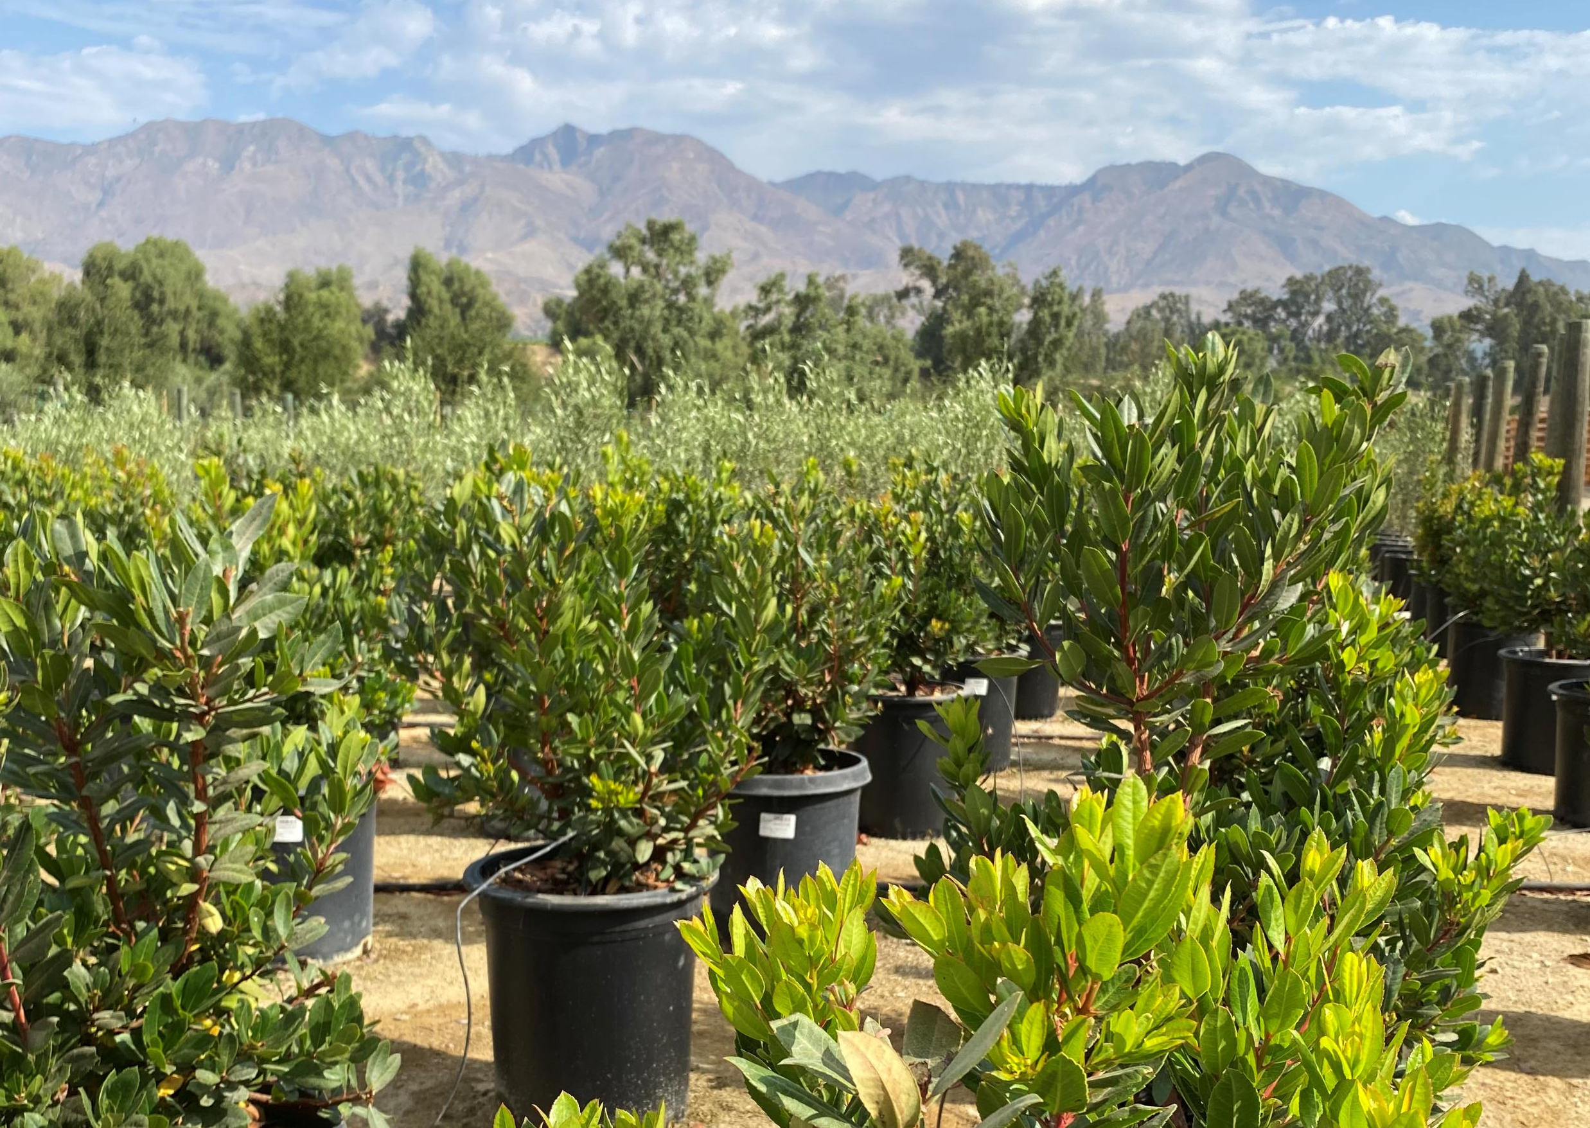
Regulatory Changes
Spray Days
Treated Seeds
School Site Pesticide Use Reporting

Slide 13
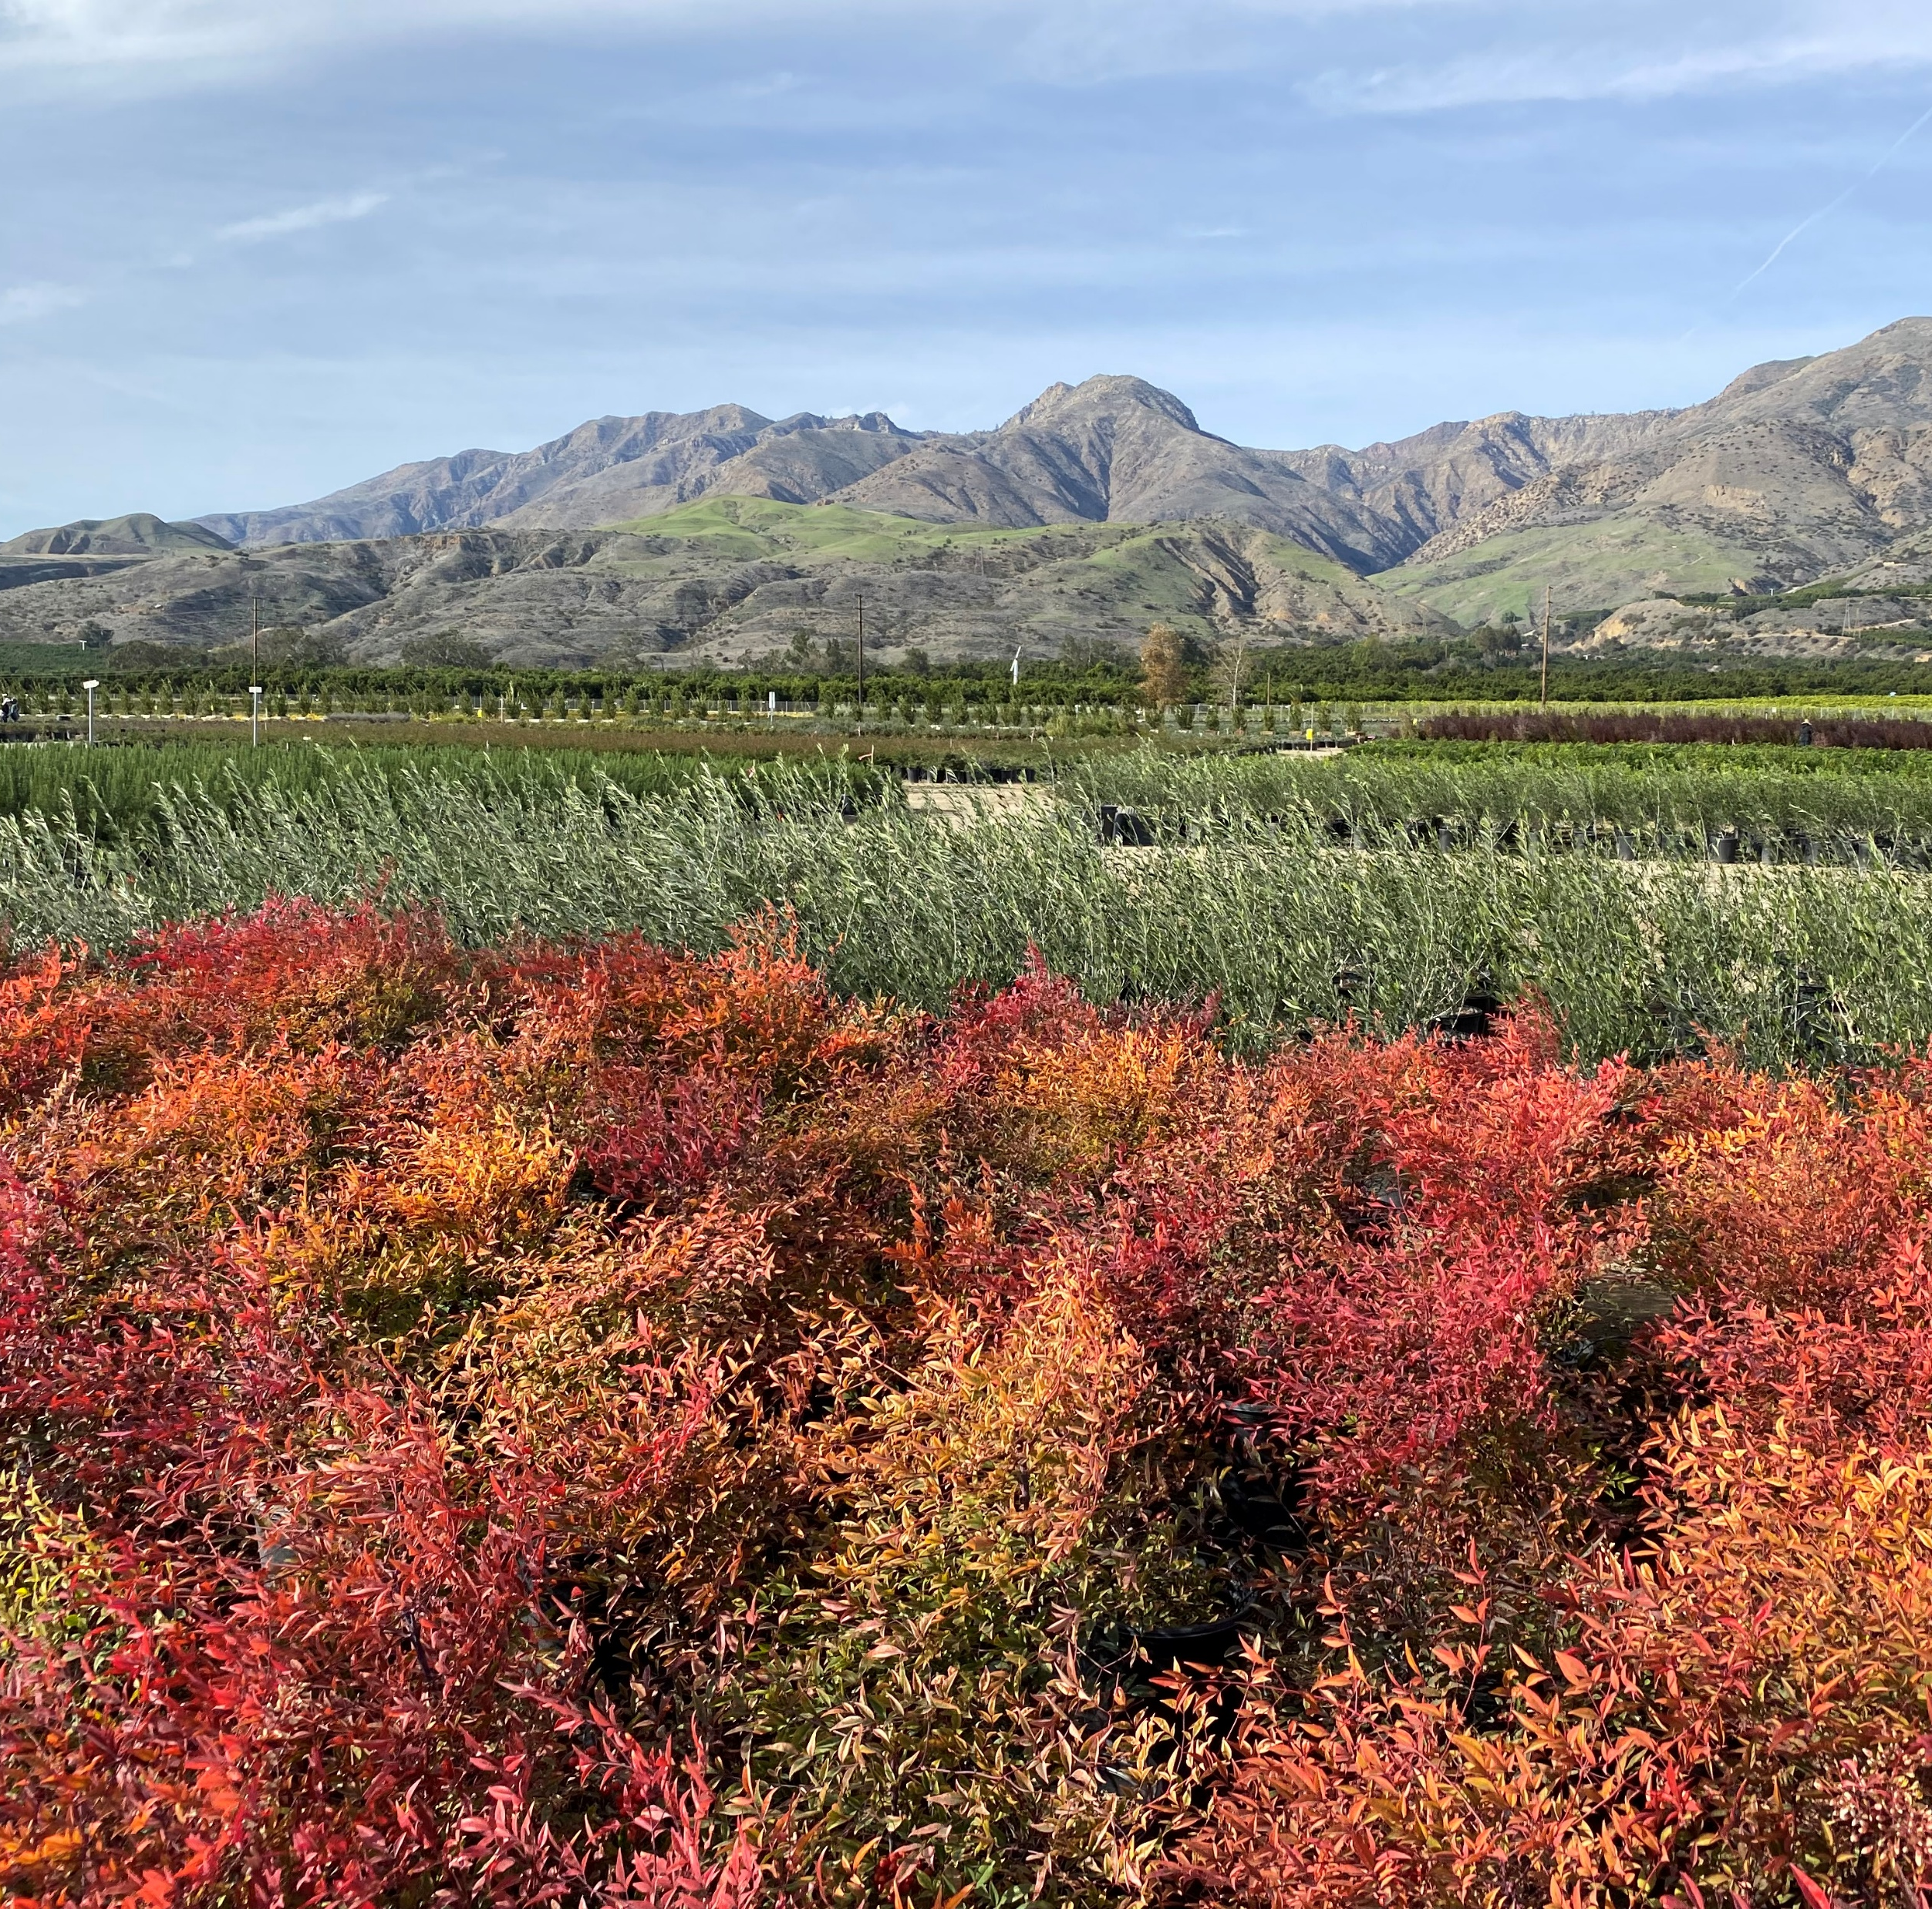
Thank you for your interest in Ventura County’s Agriculture!

